Slide 1
FACULTY OF PHILOLOGY
ADAPTATION DAY
BA STUDIES (1st degree)
28 September 2023
English Philology, academic profile

Slide 2

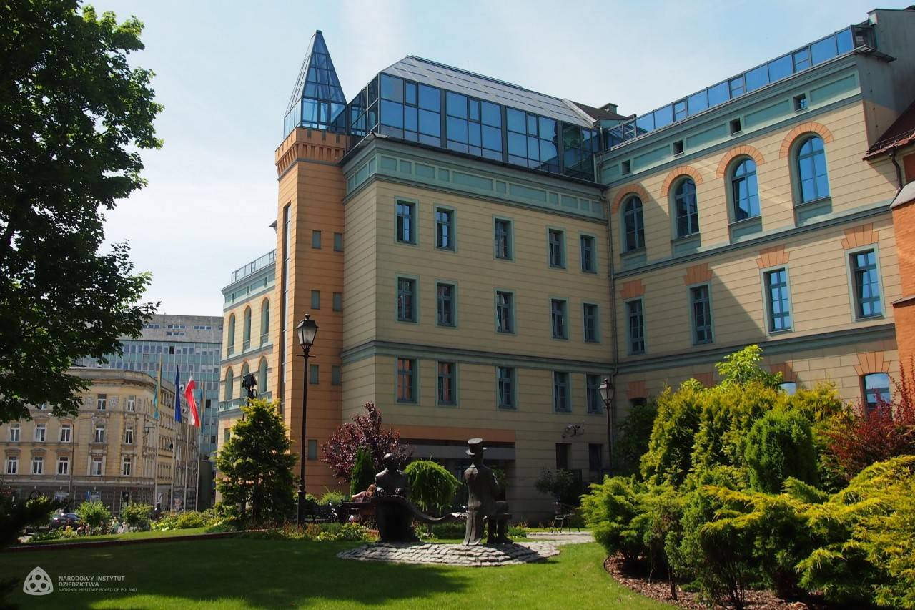

Slide 3
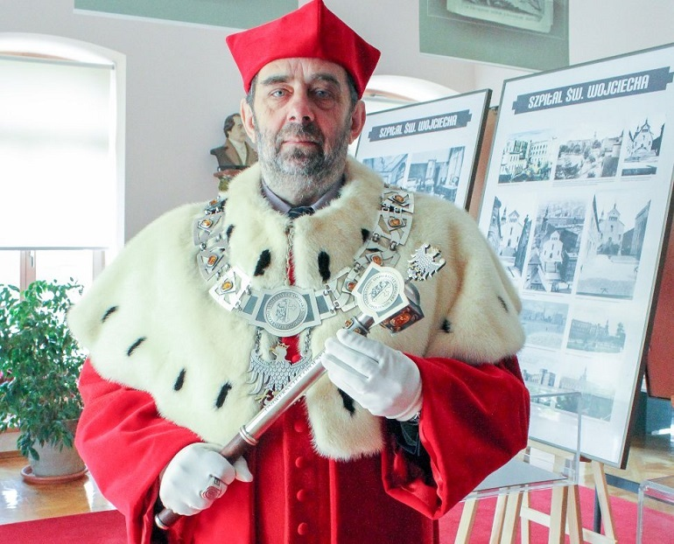
J.M. Rektor Uniwersytetu Opolskiego
Prof. dr hab. Marek Masnyk

Slide 4
STRUCTURE OF THE FACULTY
Institute of Linguistics
Headmaster: prof. J. Nocoń
Institute of Literary Studies
Headmaster: prof. R. Wolny
Dean (for didactics and student affairs)
dr Elżbieta Szymańska-Czaplak
Deputy Dean – coordinator of study programmes
dr M. Adams-Tukiendorf

Slide 5
Study Programme Coordinator
dr Małgorzata Adams-Tukiendorf
m.tukiendorf@uni.opole.pl
Room 12 Collegium Maius – consultations
see USOS web for details

Slide 6
websites
www.wfil.uni.opole.pl
www.uni.opole.pl
http://kwestura.uni.opole.pl
http://ep.wfil.uni.opole.pl/

Slide 7
USOSweb
Your email address to use nr_indeksu@student.uni.opole.pl (nr indeksu = nr albumu).
This is your logins to USOSweb https://usosweb.uni.opole.pl
Your password is the same
Centrum Nowoczesnych Technologii – in case of problems

Slide 8
Student ID
Log in to your USOS account
(you should already have both log in and password)
STUDENT folder
Payment (22PLN) (model FK)
Check out bank accounts of UO
Choose the account for student ID (download the form) – opłata za legitymację elektroniczną
When it is ready – you will be notified

Slide 9
GROUPS
Academic profile 4 groups (alphabetical order)
Gr 1 = A-F
Gr 2 = G-KO
Gr 3 = KR-SA
Gr 4= SŁ-Z

Slide 10
SCHEDULE
Check out your study programme’s website
http://ep.wfil.uni.opole.pl/

Slide 11
MONDAY 02.10.2023
G1 | G2 | G3 | G4
08:30-10:00 Language skills: writing with elements of grammar 1 Dr A. Baryłowicz Room 4 Oleska 48 | 08:30-10:00 History of British and Irish literature 1 Dr M. Marciniak Room 306 CM
 | 10:15-11:45 Language skills: writing with elements of grammar 1 Dr A. Baryłowicz Room 4 Oleska 48 |  | 10:15-11:45 History of British and Irish literature 1 Dr M. Marciniak Room 306 CM
12:00-13:30 Information technology Dr Gadzina Room 208 CM | 12:45-13:30 Information technology Dr Gadzina Room 208 CM Instead od 03.10.23 | 12:00-13:30 History of British and Irish literature 1 Dr M. Marciniak Room 306 CM | 12:00-13:30 Language skills: writing with elements of grammar 1 Dr A. Baryłowicz Room 4 Oleska 48
13:45-15:15 History of British and Irish literature 1 Dr M. Marciniak Room 306 CM | 13:45-15:15 Learning strategies Dr M. Adams-Tukiendorf Room 207A | 13:45-15:15 Information technology Dr Gadzina Room 208 CM
 |  |  | 15:30-17:00 Information technology Dr Gadzina Room 208 CM

Slide 12
Tuesday 03.10.2023
Inauguration Day
Classes of dr Wilk – cancelled for all groups
Gr 2 08:30-10:00 Information technology Dr Gadzina – come on Monday at 12:45 room 208
Gr 2 10:15-11:45 Phonetics 1 Dr E. Szymańska-Czaplak - come on Thursday at 12:00 room 207

Slide 13
Tuesday 03.10.2023
Inauguration Day – you are to participate as a representation group from the Faculty of Philology – dress formally.
Rector’s hours 10:00-14:00 (no classes)
You are to meet at 10:45 ul. W. Drzymały 1a w Opolu
The Dean will be there. Take part in the celebrations.

Slide 14
ROOMS INFO
Rooms:
Collegium Maius (PL.KOPERNIKA 11)
Main Campus (ul OLESKA 48)
Other locations possible
or ONLINE

Slide 15
ONLINE TEACHING
Microsoft Teams Platform
See the instruction video on the website of IT Center = CENTRUM NOWOCZESNYCH TECHNOLOGII https://cnt.uni.opole.pl//
use your uni.opole.pl address and password to log in
Find your teacher or course – ask for invitation if you haven’t received one

Slide 16
Workshop on Students’ Rights
Obligatory
will be announced soon
Observe the Lates News
on the Faculty’s website

Slide 17
Safety Training (4h)
one meeting - OBLIGATORY
will be announced soon
Observe the Lates News
on the Faculty’s website

Slide 18
Library Training (2h)
English Library Collegium Maius room 011
one meeting - OBLIGATORY
will be announced soon
Observe the Lates News
on the Faculty’s website

Slide 19
UO Library
You need your student ID to become a member
Library of the Faculty of Philology
Collegium Maius (CM) sala 011 (podziemie)
Main Library
ul. Strzelców Bytomskich 2
Details during your Library training - OBLIGATORY

Slide 20
Academic year organisation
Check out your study programme website for details

Slide 21
CONFIRMATION OF YOUR STUDENT STATUS
DEAN’S OFFICE
Open Tuesday-Friday
10:00-14:00

Slide 22
Representatives
Each group needs one person to represent the group at the dean’s office
Select now
Pass the contact info to the Study programme coordinator

Slide 23
ECTS
ECTS = European Credit Transfer System
(Europejski System Transferu Punktów)
You need to collect 30 points each semester
Some courses are variable and obligatory (e.g. foreign language course – SJO, university wide course, Physical Education – SWF, elective, diploma seminar) – enroll via USOSweb
USOS web – most important info re courses in the teaching programme

Slide 24
questions?

