Slide 1
FACULTY OF PHILOLOGY
ADAPTATION DAY
BA STUDIES (1st degree)
English Philology, academic profile
PART TIME

Slide 2

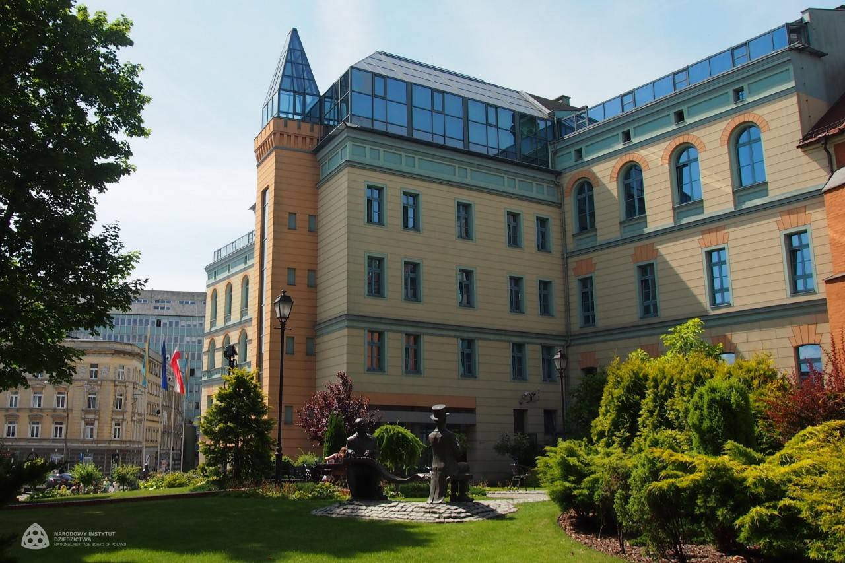

Slide 3
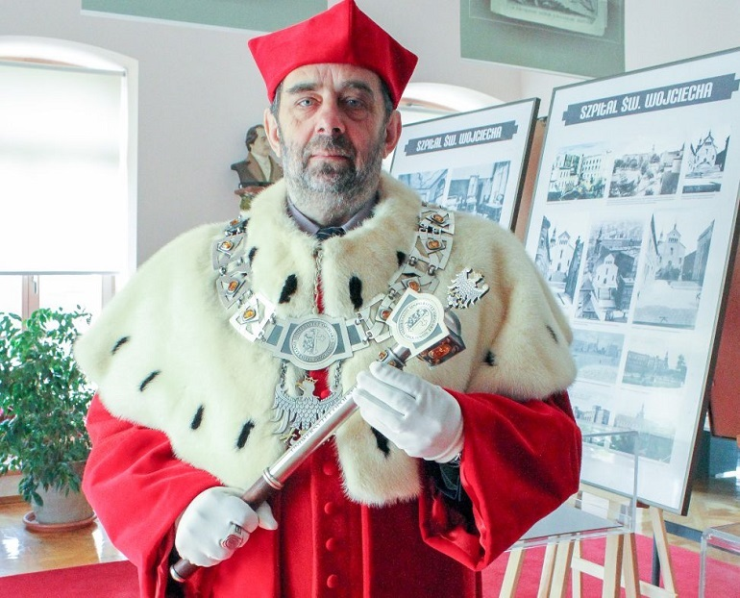
J.M. Rektor Uniwersytetu Opolskiego
Prof. dr hab. Marek Masnyk

Slide 4
STRUCTURE OF THE FACULTY
Institute of Linguistics
Headmaster: prof. J. Nocoń
Institute of Literary Studies
Headmaster: prof. R. Wolny
Dean (for didactics and student affairs)
dr Elżbieta Szymańska-Czaplak
Deputy Dean – coordinator of study programmes
dr M. Adams-Tukiendorf

Slide 5
Study Programme Coordinator
dr Małgorzata Adams-Tukiendorf
Room 12 Collegium Maius – consultations
see USOS web for details

Slide 6
websites
www.wfil.uni.opole.pl
www.uni.opole.pl
http://kwestura.uni.opole.pl
http://ep.wfil.uni.opole.pl/

Slide 7
USOSweb
Your email address to use nr_indeksu@student.uni.opole.pl (nr indeksu = nr albumu).
This is your logins to USOSweb https://usosweb.uni.opole.pl
Your password is the same
Centrum Nowoczesnych Technologii – in case of problems

Slide 8
Student ID
Log in to your USOS account
(you should already have both log in and password)
STUDENT folder
Payment 22pln (model FK)
Check out bank accounts of UO
Choose the account for student ID (download the form) – opłata za legitymację elektroniczną
When it is ready – you will be notified

Slide 9
SCHEDULE
Check out your study programme’s website
http://ep.wfil.uni.opole.pl/

Slide 10
ROOMS INFO
Rooms:
Collegium Maius (PL.KOPERNIKA 11)
or ONLINE

Slide 11
ONLINE TEACHING
Microsoft Teams Platform
See the instruction video on the website of IT Center = CENTRUM NOWOCZESNYCH TECHNOLOGII
https://centrum.uni.opole.pl/narzedzia-do-pracy-zdalnej/
use your uni.opole.pl address and password to log in
Find your teacher or course – ask for invitation if you haven’t received one

Slide 12
Safety Training (4h)
one meeting - OBLIGATORY
07.10.2022 – in POLISH
15:00-18:00
Room 306 CM
If you request this workshop in English – contact the coordinator of the study programme

Slide 13
Library Training (2h)
English Library Collegium Maius room 011
one meeting - OBLIGATORY
14.10.2022
11:30-13:00

Slide 14
UO Library
You need your student ID to become a member
Library of the Faculty of Philology
Collegium Maius (CM) sala 011 (podziemie)
Main Library
ul. Strzelców Bytomskich 2
Details during your Library training - OBLIGATORY

Slide 15
Academic year organisation
Check out your study programme website for details

Slide 16
CONFIRMATION OF YOUR STUDENT STATUS
DEAN’S OFFICE
For extramural students on selected Saturdays – monitor the faculty’s website - http://wfil.uni.opole.pl/dziekanat/

Slide 17
Representatives
The group needs one person to represent the group at the dean’s office
Choose now

Slide 18
ECTS
ECTS = European Credit Transfer System
(Europejski System Transferu Punktów)
You need to collect 30 points each semester
Some courses are variable and obligatory (e.g. foreign language course, university wide course, elective, diploma seminar)
USOS web – most important info re courses in the teaching programme

Slide 19
questions?

