Slide 1
FACULTY OF PHILOLOGY
ADAPTATION DAY
BA STUDIES
28.09.2021
English in Public Communication

Slide 2

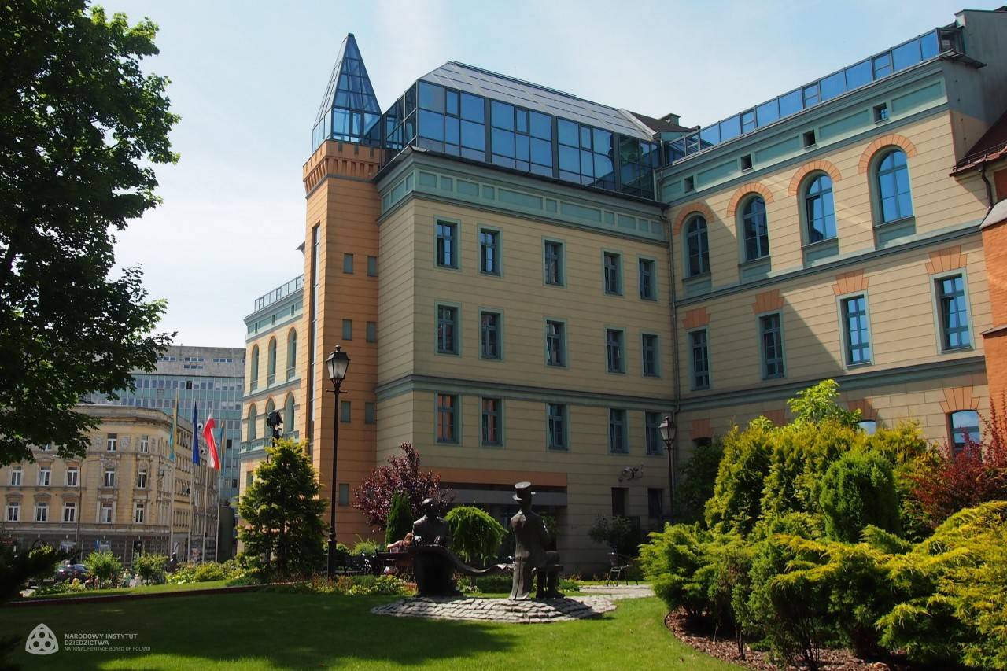

Slide 3
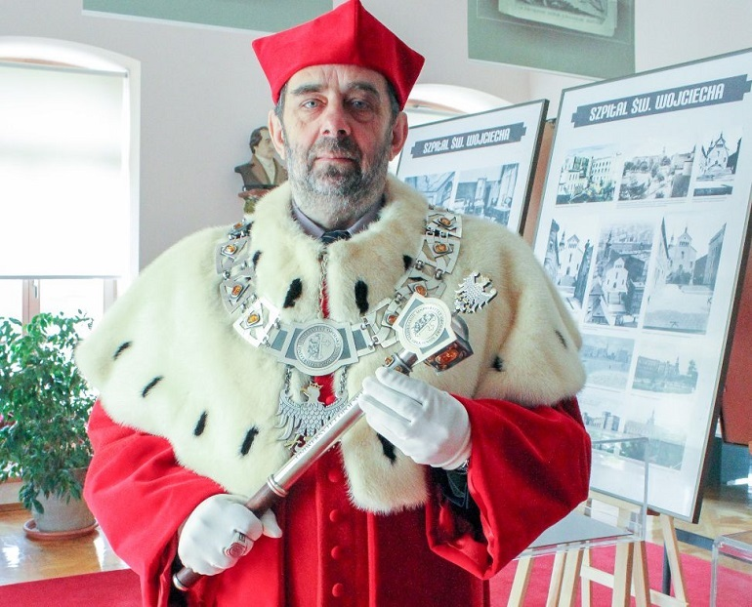
J.M. Rektor Uniwersytetu Opolskiego
Prof. dr hab. Marek Masnyk

Slide 4
STUCTURE OF THE FACULTY
Institute of Linguistics
Headmaster: prof. Jolanta Nocoń
Institute of Literary Studies
Headmaster: prof. Ryszard Wolny
Dean (for didactics and student affairs)
dr Elżbieta Szymańska-Czaplak
Deputy Dean – coordinator of study programmes
dr Małgorzata Adams-Tukiendorf

Slide 5
Program coordinator
dr Małgorzata Adams-Tukiendorf
m.tukiendorf@uni.opole.pl
Room 12 Collegium Maius – consultations
see USOS web for details

Slide 6
websites
wfil.uni.opole.pl
uni.opole.pl
usosweb.uni.opole.pl
kwestura.uni.opole.pl
epc.wfil.uni.opole.pl

Slide 7
USOSweb
Your email address to use nr_indeksu@student.uni.opole.pl (nr indeksu = nr albumu).
This is your logins to USOSweb https://usosweb.uni.opole.pl
Your password is the same
Centrum Nowoczesnych Technologii – in case of problems

Slide 8
Student ID
Log in to your USOS account
(you already should have both log in & password)
STUDENT folder
Payment (model FK) – 22 PLN
Check out bank accounts of UO
Choose the account for student ID (download the form) – opłata za legitymację elektroniczną
When it is ready – you will be notified

Slide 9
Groups
You are divided into three groups
Alphabetically
Group 1
Group 2
Group 3

Slide 10
SCHEDULE
Check out your study programme’s website
epc.wfil.uni.opole.pl

Slide 11
Monday 02.10.2023
G1 | G2 | G3
10:15-11:45 Phonetics 1 Dr E. Szymańska-Czaplak Room 207CM | 10:15-11:45 Communication Theories and Semiotics Dr hab. K. Molek-Kozakowska, prof. UO Room 206 CM | 10:15-11:45 Phonetics 1 Dr E. Szymańska-Czaplak Room 207CM
12:00-13:30 Communication Theories and Semiotics Dr hab. K. Molek-Kozakowska, prof. UO Room 206 CM | 12:00-13:30 Phonetics 1 Dr E. Szymańska-Czaplak Room 207CM | 12:00-13:30 Communication Theories and Semiotics Dr hab. K. Molek-Kozakowska, prof. UO Room 206 CM
13:45-15:15
1500-16:00 Personal and Career Development Dr M. Adams-Tukiendorf Room 207a CM

Slide 12
Tuesday 03.10.2023
Inauguration Day (ul. W. Drzymały 1)
11:00-13:00
Rector’s hours 10:00-14:00 (no classes)
Your classes at 08:30-10:00 – cancelled
Your classes at 13:45-15:15 – cancelled

Slide 13
ROOMS INFO
Rooms:
Collegium Maius (PL.KOPERNIKA 11)
Main Campus (ul OLESKA 48/ pl. Staszica 1)
Other locations possible
or ONLINE

Slide 14
ONLINE TEACHING
Microsoft Teams Platform
See the instruction video on the website of IT Center = CENTRUM NOWOCZESNYCH TECHNOLOGII https://cnt.uni.opole.pl//
use your uni.opole.pl address and password to log in
Find your teacher or course – ask for invitation if you haven’t received one

Slide 15
Workshop on Students’ Rights
Obligatory
will be announced soon
Observe the Lates News
on the Faculty’s website

Slide 16
Safety Training (4h)
one meeting - OBLIGATORY
will be announced soon
Observe the Lates News
on the Faculty’s website

Slide 17
Library Training (2h)
English Library Collegium Maius room 011
one meeting - OBLIGATORY
will be announced soon
Observe the Lates News
on the Faculty’s website

Slide 18
UO Library
You need your student ID to become a member
Library of the Faculty of Philology
Collegium Maius (CM) room 011 (downstairs)
Main Library
ul. Strzelców Bytomskich 2
Details during your Library Training - OBLIGATORY

Slide 19
Academic year organisation
Check out your study programme website for details

Slide 20
CONFIRMATION OF YOUR STUDENT STATUS
DEAN’S OFFICE
Open Tuesday-Friday
10:00-14:00

Slide 21
Representatives
Each group needs one person to represent the group at the dean’s office
Select now
Pass the contact info to the Study programme coordinator

Slide 22
ECTS
ECTS = European Credit Transfer System
(Europejski System Transferu Punktów)
You need to collect 30 points each semester
Some courses are variable and obligatory – (University wide course, PE, foreign language, elective, diploma seminar - enroll via USOSweb)
EPC website and USOS web – most important info regarding courses in the teaching programme

Slide 23
questions?

