Slide 1



Slide 2

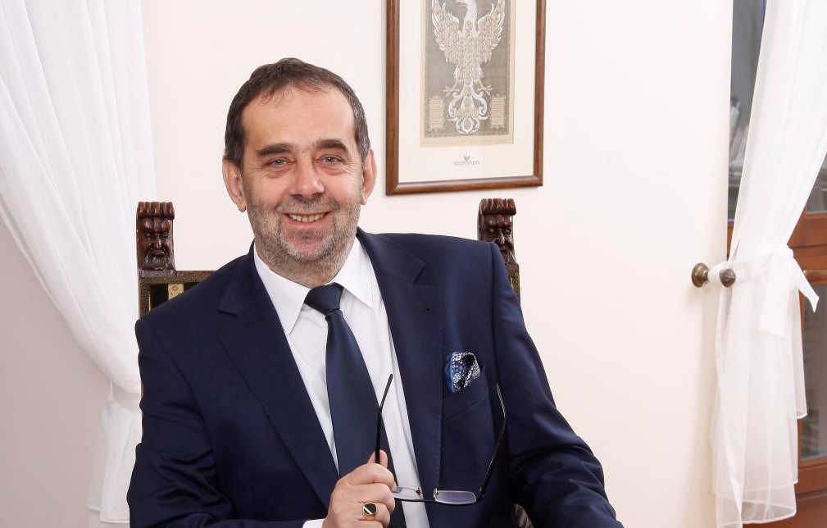
The University of Opole combines tradition with modernity. Studying here will provide you with solid knowledge, that guarantees a promising and satisfying job in the future, but also it will be a great intellectual adventure and life experience.
Professor Marek Masnyk
Rector of the University of Opole
2

Slide 3

HISTORY OF THE UNIVERSITY OF OPOLE
26 X 1954
1954
The transfer of the State Higher School of Pedagogy from Wroclaw to Opole.
8 V 1970
The initiative to transform the Higher School of Pedagogy into a university.
1970
30 X 1989
1989
The establishment of the Foundation for the University of Opole and the election of Professor Stanisław Nicieja as President of the Foundation
3

Slide 4

25 VIII 1993
1993
The consent of the Polish Bishops' Conference to the establishment of a theological faculty at the future University of Opole.
17 XI 1993
The referral of the parliamentary bill on the establishment of the University of Opole, to the Commission for Education, Science and Technical Progress.
1993
10 III 1994
1994
The Act on establishing the University of Opole was passed by the Lower Chamber of the Parliament of the Republic of Poland .
23 III 1994
The Act on establishing the University of Opole was passed by the Senate of the Republic of Poland.
1994
18 IV 1994
1994
The Act on establishing the University of Opole was signed by Lech Wałęsa, President of the Republic of Poland.
4

Slide 5

12 FACULTIES
70 FIELDS OF STUDY
10 000 STUDENTS
1800 PLACES IN HALLS OF RESIDENCE
700 SCHOLARS
1,000,000 VOLUMES

Slide 6













Structure
Institute of Biology
Institute of Chemistry
Institute of Economics and Finance
Institute of Physics
Institute of Socio-Economic Geography and Spatial Management
Institute of History
Institute of Computer Science
Institute of Environmental Engineering and Biotechnology
Institute of Lingiustics
Institute of Medical Science
Institute of Literature Science
Institute of Political Sciences and Administration
Institute of Management and Quality Science
Institute of Health Science
Institute of Pedagogical Sciences
Institute of Law Sciences
Institute of Theological Science
Institute of Psychology
Institute of Visual Arts

Slide 7
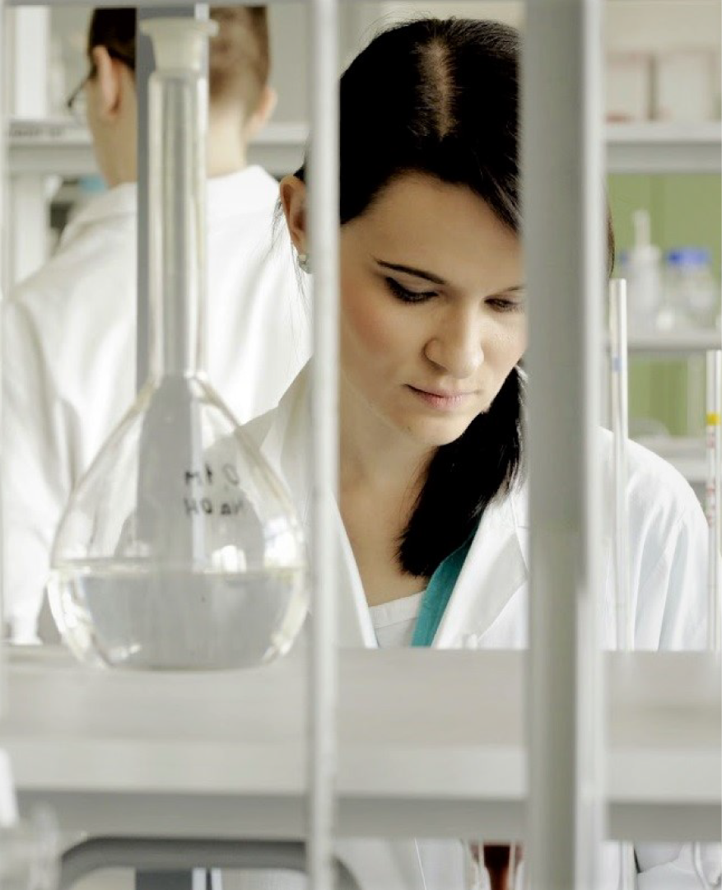

The Faculty of Chemistry cooperates with a number of foreign scientific institutions, inter alia, from Sweden, Austria, Italy, Spain, Czech Republic, and Slovakia. Students deepen their knowledge in the fields of inorganic, physical, theoretical, organic, analytical, and ecological chemistry, or chemical technology. They can also participate in internships both in Poland and abroad.
The Faculty of Chemistry is a beneficiary of the largest number of research grants at the University of Opole. The grants are financed by the National Science Centre, the National Centre for Research and Development, and the Innovative Economy Operational Programme.

Slide 8
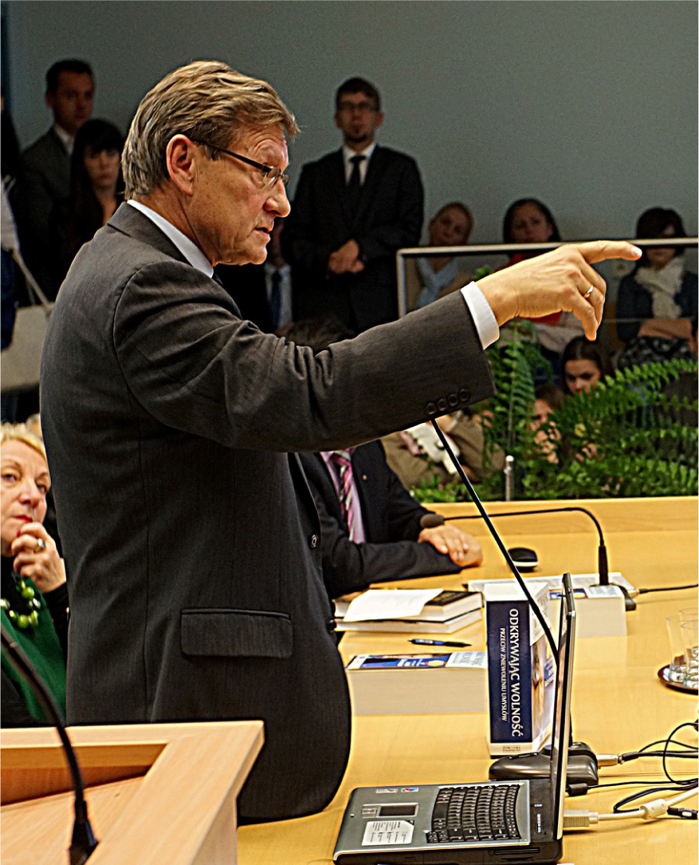

The Faculty of Economics employs highly qualified staff conducting research in various areas of economics. The scholars of the faculty bring tangible results to the University’s research profile. It means a number of works whose quality has been proven by numerous citations in the scientific literature.
Graduates of the Faculty of Economics quickly find employment both in Poland and abroad. Comprehensively educated, they can look at the economic phenomena both from the microeconomic and macroeconomic perspectives. For these reasons they are well fit with the needs of the labour market, becoming managers in private companies as well as state and local administration.

Slide 9
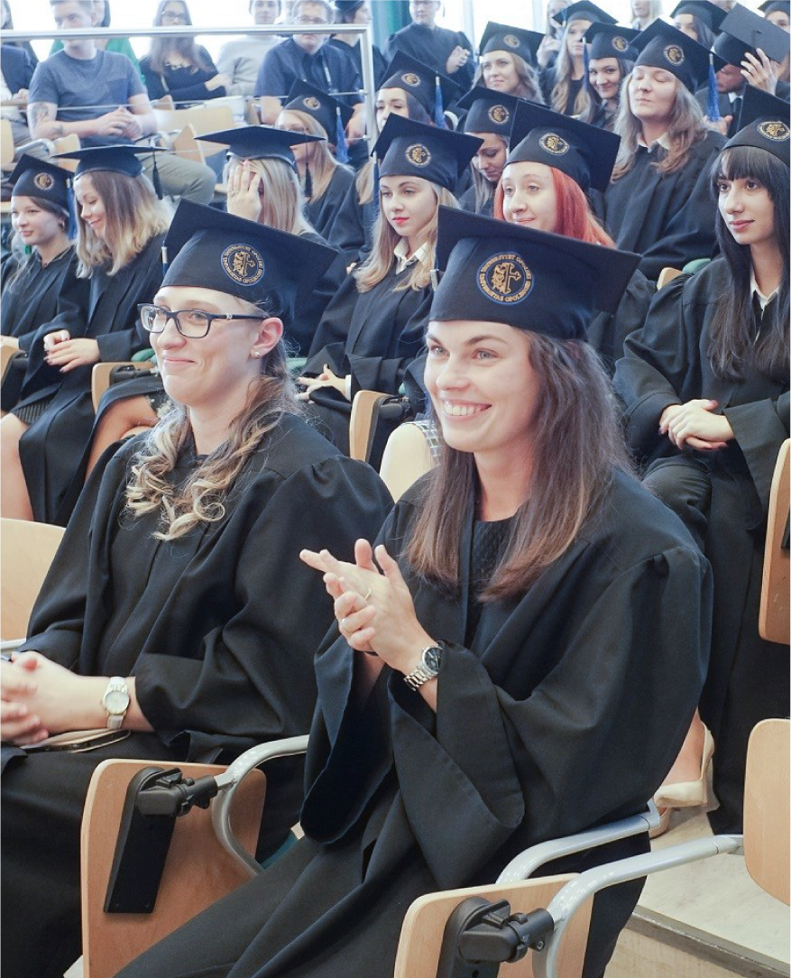

The Faculty combines long-standing traditions with modern and creative education in a friendly environment. It cooperates with educational institutions all over the world. The Faculty has been highly evaluated by the Polish Accreditation Committee and the Ministry of Science and Higher Education. The Faculty has one of the best English Philology programs in the country.
Almost fifty professors, hundred doctors, and lecturers provide students with the highest level of education. The Faculty’s priority is to prepare students for the needs of the labour market.
To this end, the Faculty cooperates with other educational institutions, local government bodies, and social-cultural organisations. Students of the faculty benefit from local and international cooperation, as it allows them to do so needed internships. It all contributes to the fact that graduates of the Faculty of Philology are professionals of great value to future employers.

Slide 10
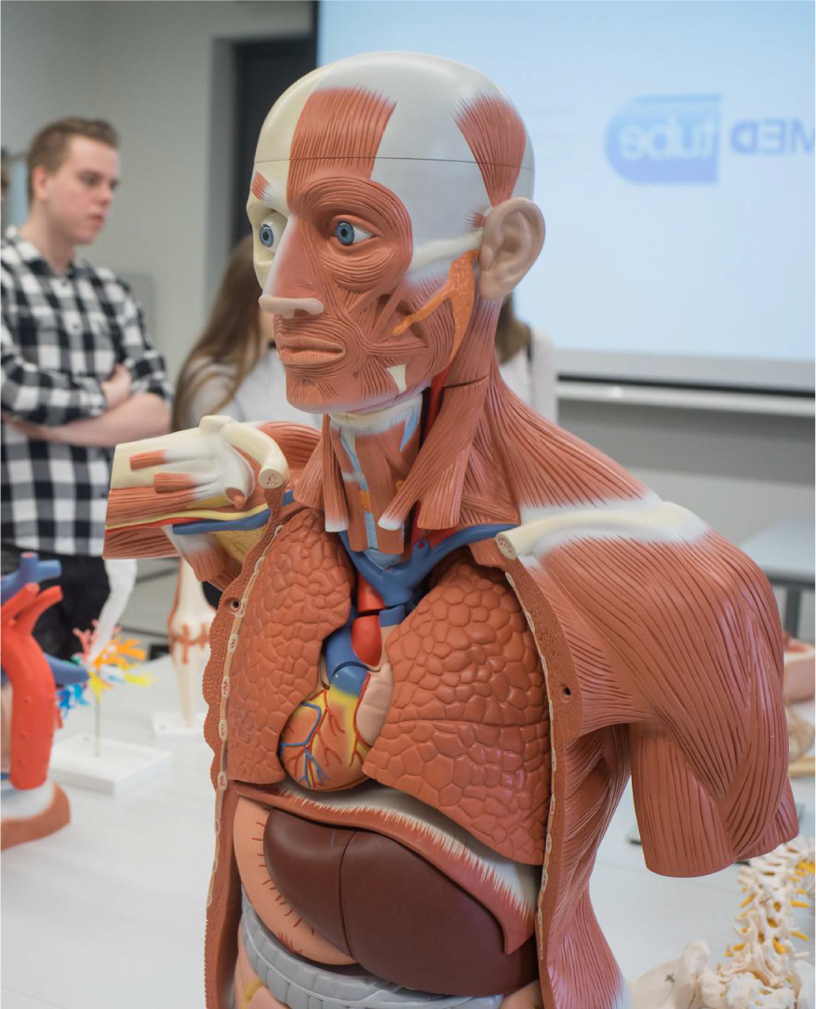

Faculty of Medicine
Faculty of Medicine has a great teaching staff consisting of physicians and researchers of national fame.
Faculty has well-equipped laboratories, with a unique multi-profile Centre of Medical Simulation and "Virtual heart” application.
Students’ internships take place under the guidance of excellent professionals in more than twenty best hospitals in the region, including the University Hospital of Opole.
Students take part in student research groups and organise preventive actions for the benefit of the inhabitants of Opole and the Opole region.

Slide 11
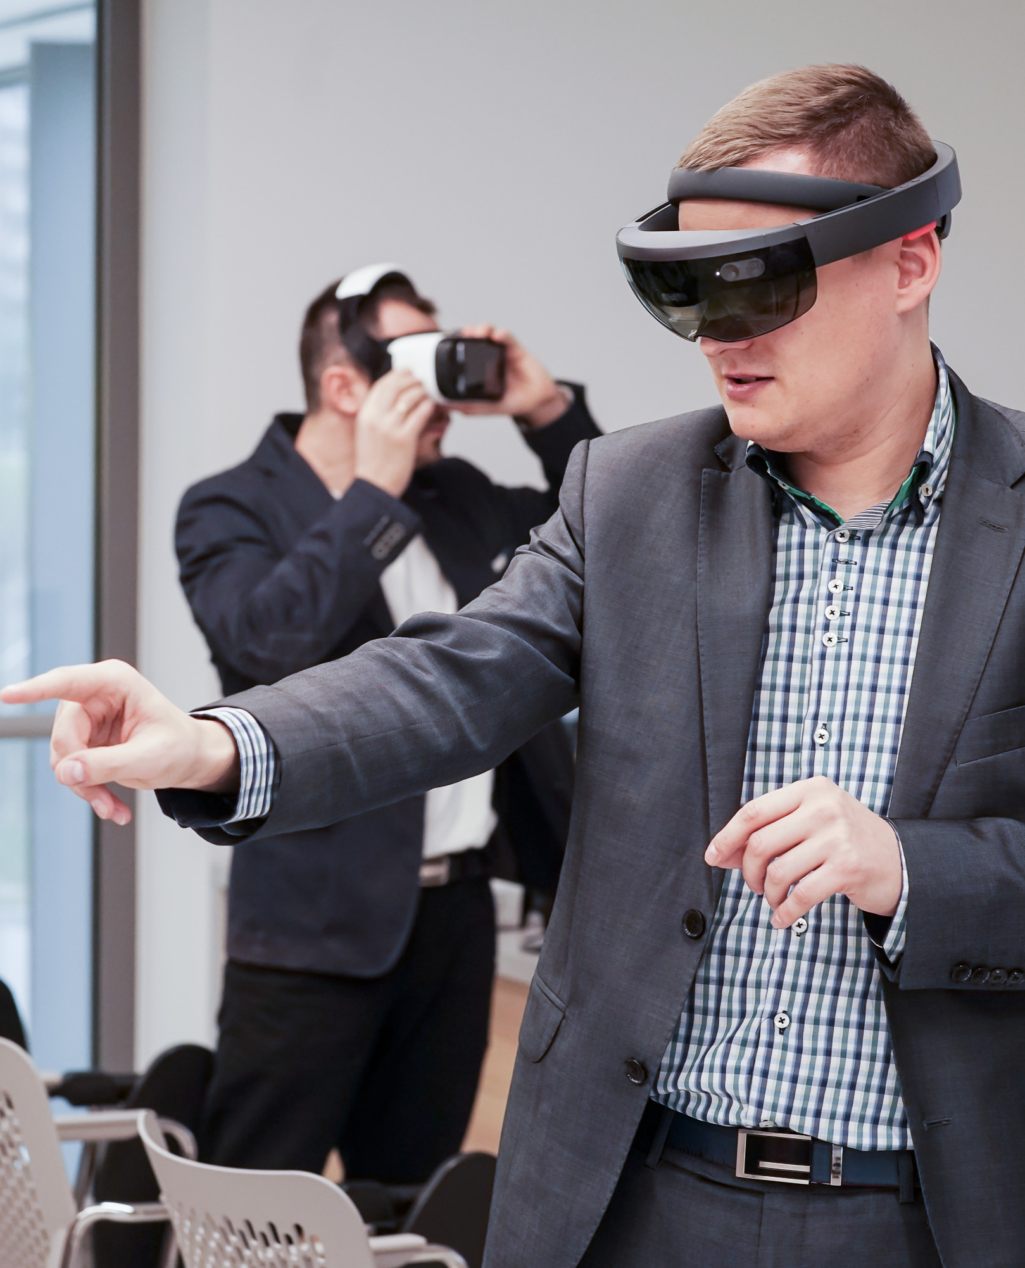


The Faculty is of an interdisciplinary character. It employs excellent academics, a number of whom are internationally recognised specialists working in the EU expert groups, consulting large research projects carried out in Europe.
Graduates can find attractive work in IT, finance and insurance, education, industry, and even medical services.

Slide 12
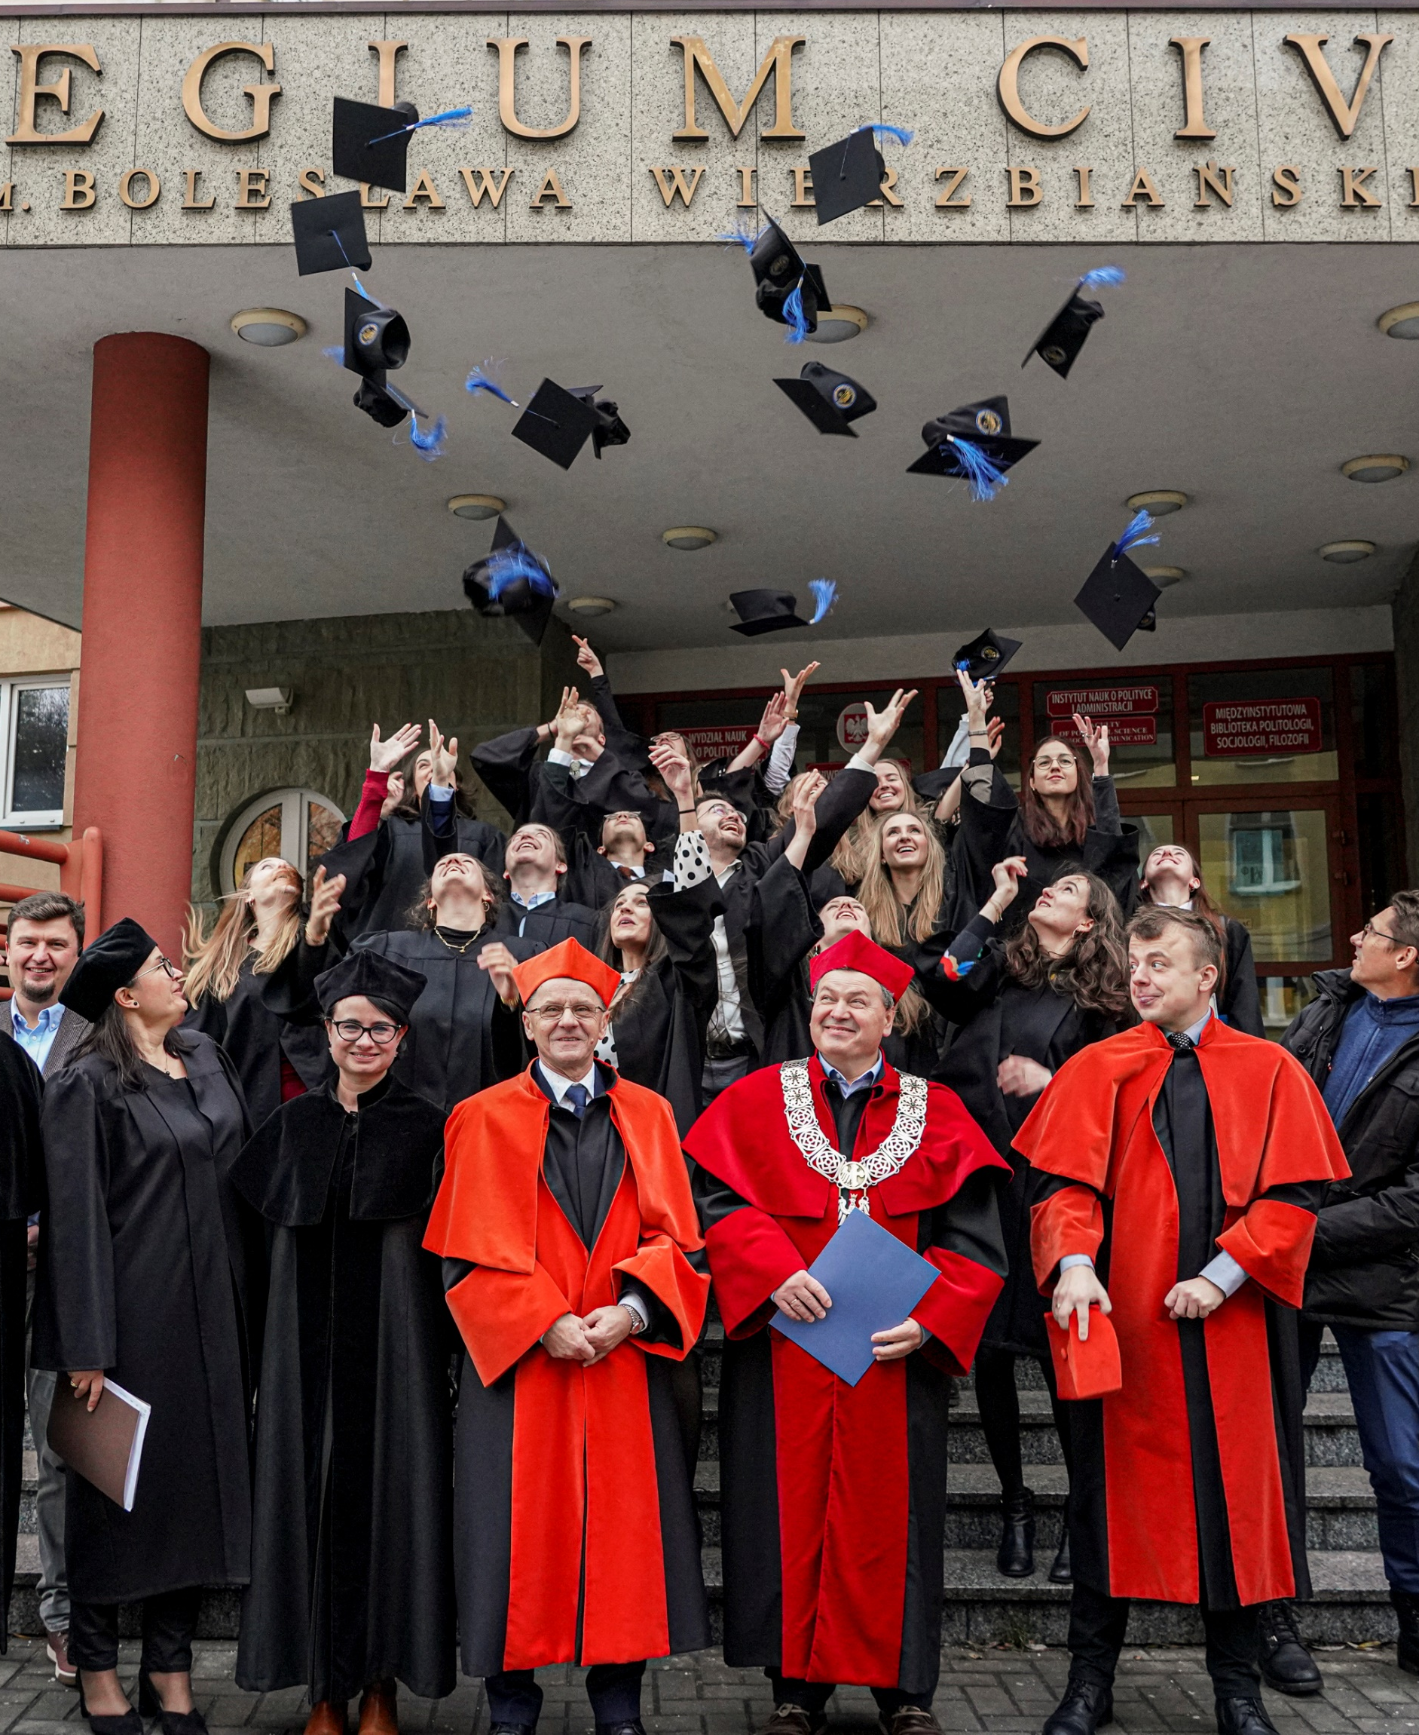

The faculty emerged from the Faculty of Social Sciences in 2019.
It conducts a unique Europe Master programme, enabling students to simultaneously obtain master's degrees from three universities: University of Opole, University of Johannes Gutenberg in Mainz, and University of Burgundy in Dijon.
Graduates of the Faculty of Political Science and Social Communication are well prepared to work in the public administration or the media.

Slide 13
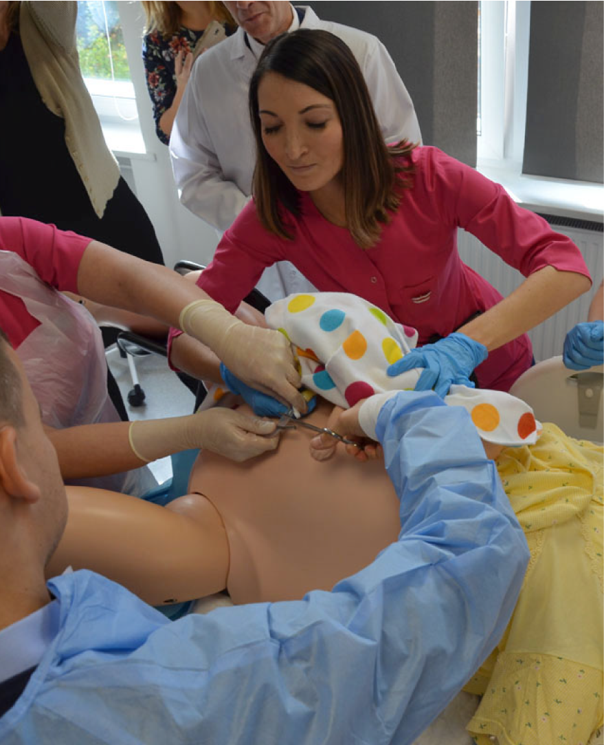

It was established on the basis of the State Higher Medical School of Opole, which was incorporated into the structures of the University of Opole on July 15, 2020.
The faculty has 5 study programmes: dietetics (bachelor's degree), physiotherapy (single master's and second degree), cosmetology (bachelor's degree), nursing (bachelor's and master's degree) and obstetrics (bachelor's and master's degree).
Students have at their disposal modern, well-equipped laboratories and teaching rooms, especially the Innovative Medical Simulation Center, which includes nine specialized rooms, such as high-fidelity rooms dedicated to nursing or obstetrics, equipped with modern apparatus and phantoms.

Slide 14


It is one of the bigger faculties of our university, with over 200 distinguished researchers.
Here one can become a comprehensively educated specialist in such fascinating fields as philosophical coaching, design and social communication, or musicology. The faculty offers also traditional but very popular study programmes, like special education, psychology, and sociology.

Slide 15
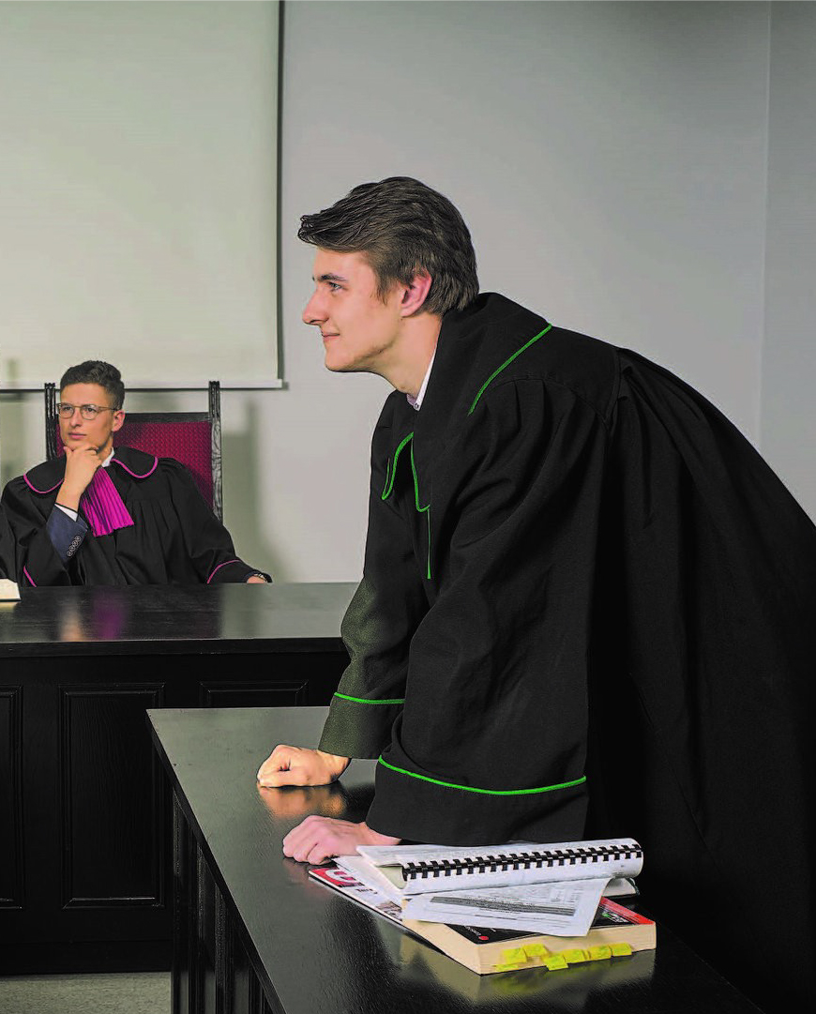

In the four fields of study – Law, Administration, Business Support Administration, and Internal Security - leaders of tomorrow are being prepared to face the challenges of a rapidly changing reality.
Students have their classes in Collegium Iuridicum located in the middle of the University campus. In the building with modern teaching rooms and a rich library there is also a courtroom where students carry out mock trials. Students are taught not only by academic teachers, but also by judges, solicitors, tax specialists , in other words, lawyers and administration specialists currently performing their professions.
The Faculty is an active participant of national and international student exchange programmes: Erasmus+ and MOST, and it cooperates with the Police Academy in Szczytno and Voivodeship Headquarters of Police in Opole. Students do attractive internships and placements in the Ministry of Justice, the Polish Robert Schuman Foundation, the European Commission, the European Court of Justice, and the European Parliament.

Slide 16


The studies at the Faculty of Natural Sciences and Technology are recommended for candidates interested in microbiology, palaeobiology, biochemistry, molecular biology, genetics, environmental protection, bioengineering, bioinformatics, medicine, and environmental engineering, as well as teaching natural science, biology and geography.
The Faculty has a scientific supervision over the palaeontological excavation site in Krasiejów, which is considered to be one of the most valuable sites in the world. There has been made a sensational discovery of Triassic proto-dinosaurs. A few years ago an enormous dinopark was opened in the quarry.
In the modern Collegium Biotechnologicum there are three floors with state-of-the-art laboratories.
Graduates will find employment in environmental industry, medicine, and IT centres.

Slide 17
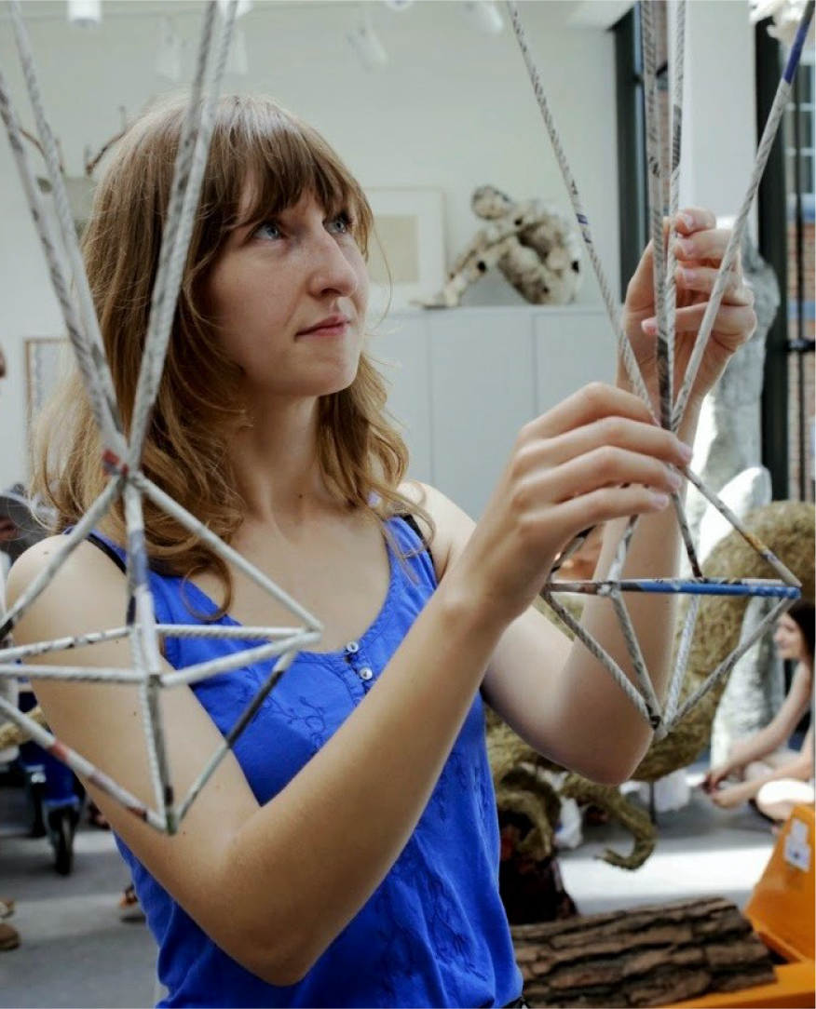

Students’ creative passions are developed in the following areas: painting, graphics, drawing, sculpture, new media, photography, graphic design, visual structures, and history and theory of art. Art classes are conducted in small groups, which allows for active and individual contact between teachers and students.
Students are taught classical art techniques (painting, drawing, sculpture, graphics), creative use of digital media (animation, graphic design, multimedia, digital art), the transmission of information through the work of art.
The advantage of studying at the Faculty of Arts is a friendly and intimate atmosphere, and the asset is the immediate vicinity of all art studios (all in one building), which facilitates work on intermedia projects.

Slide 18
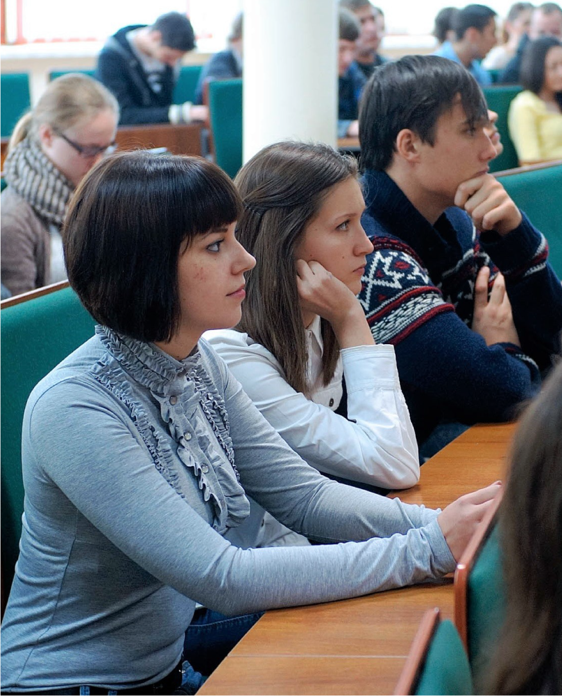

The Faculty offers three study programmes: theology (MA and PhD), family studies (BA, MA and PhD), and tourism and Mediterranean culture (BA and MA). Graduates can work in schools as religion teachers, in social support centres, family counselling centres, local government and parish pastoral groups.
In 2000, the Faculty of Theology became a member of the European Federation of Catholic Universities. For years the Faculty has been cooperating with research centres in the country and abroad (Bamberg, Mainz, Munster, Regensburg, Prague, Olomouc, Trnava).
The high quality of education is guaranteed by Rev. Professor Archbishop Alfons Nossol, honorary doctor of six universities.

Slide 19
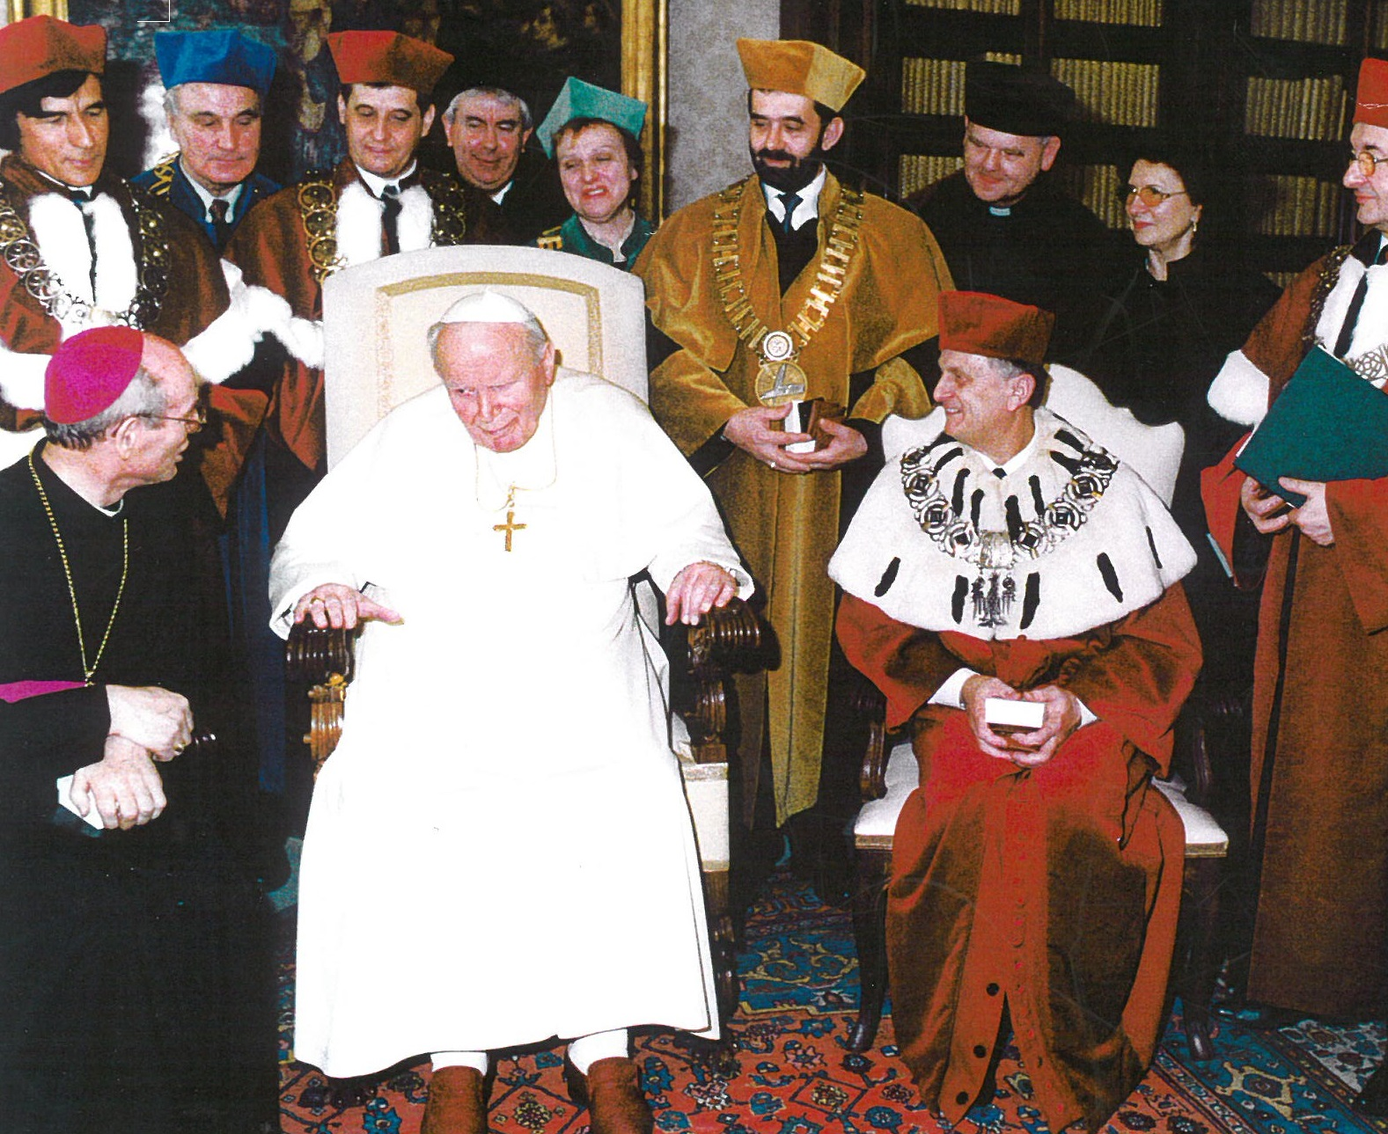
50 HONORARY DOCTORS
OF THE UNIVERSITY OF OPOLE
Doctors honoris causa, (Latin for "the sake of honour’) are people with outstanding merit in the field of culture, art, science, or politics. Universities award honorary degrees in recognition of these merits.
According to the Regulations of the University of Opole, the title of an honorary doctor can receive a "creator of scientific, cultural and social achievements of outstanding rank, which set new and significant ways of understanding and reconciliation among people, cultures, communities, and nations. These achievements may expand the horizons of knowledge or culture, and represent the common good of the importance to local or supralocal. An honorary doctor may be granted to a person building a structural base for such actions."
The title of an honorary doctor can be awarded to a person with no formal education but it should be kept in mind that it is usually bestowed on people with a high social or scholarly status.
Ceremony of bestowing the honorary doctorate on Pope John Paul II.
Vatican, February 17, 2004.
19

Slide 20

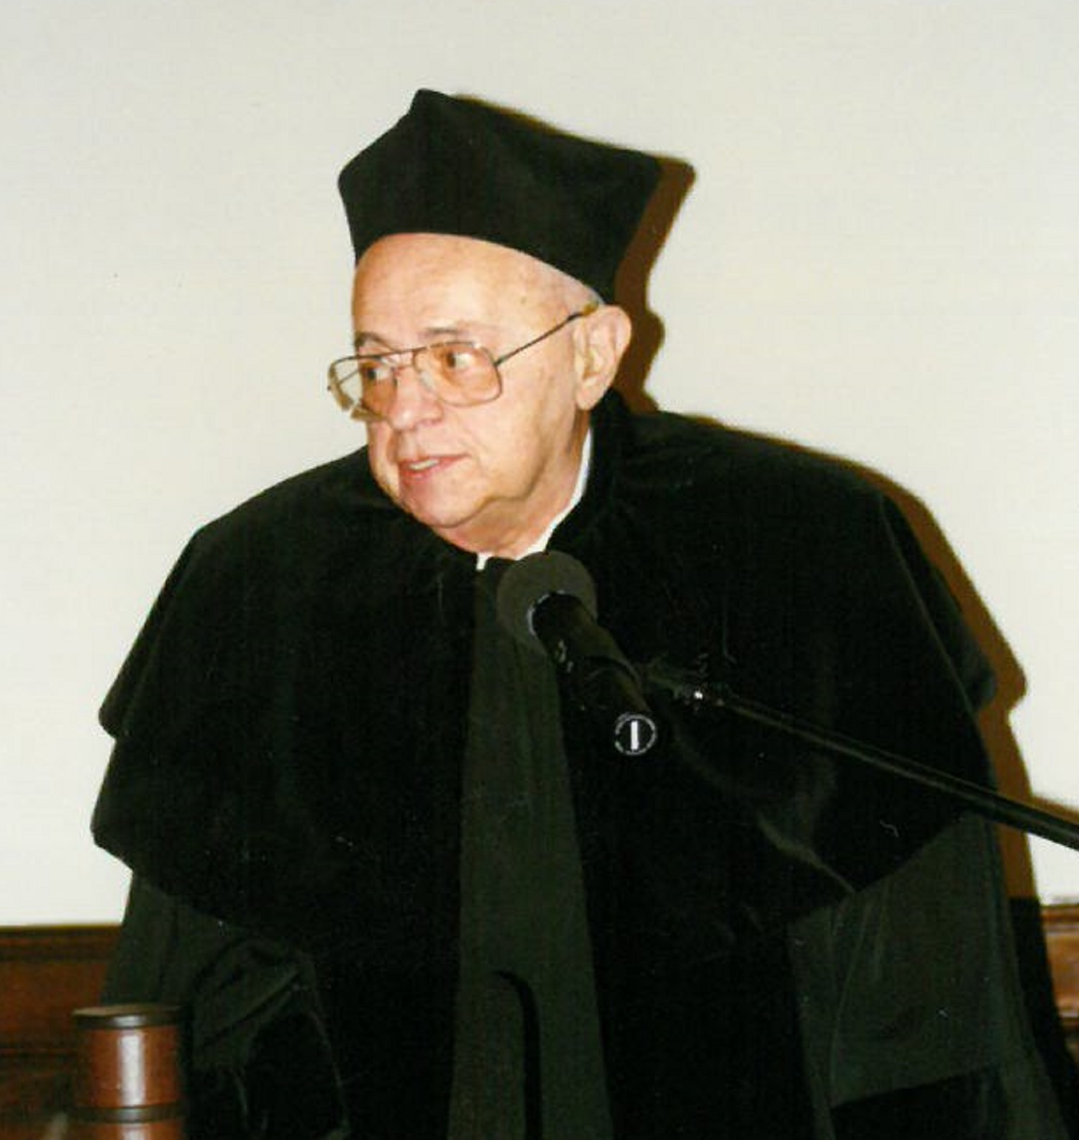
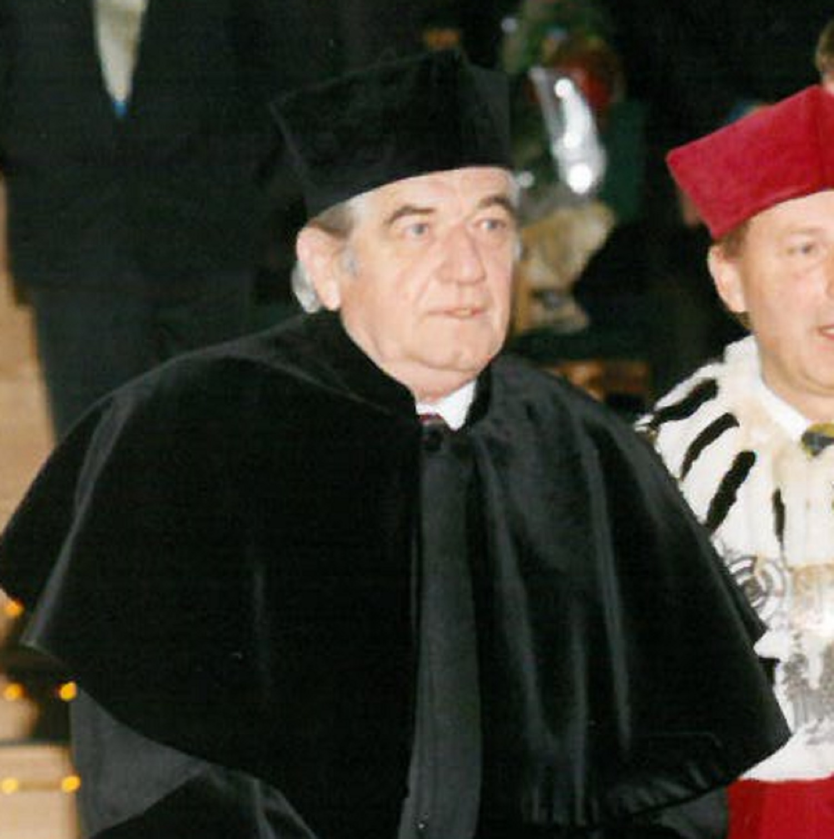
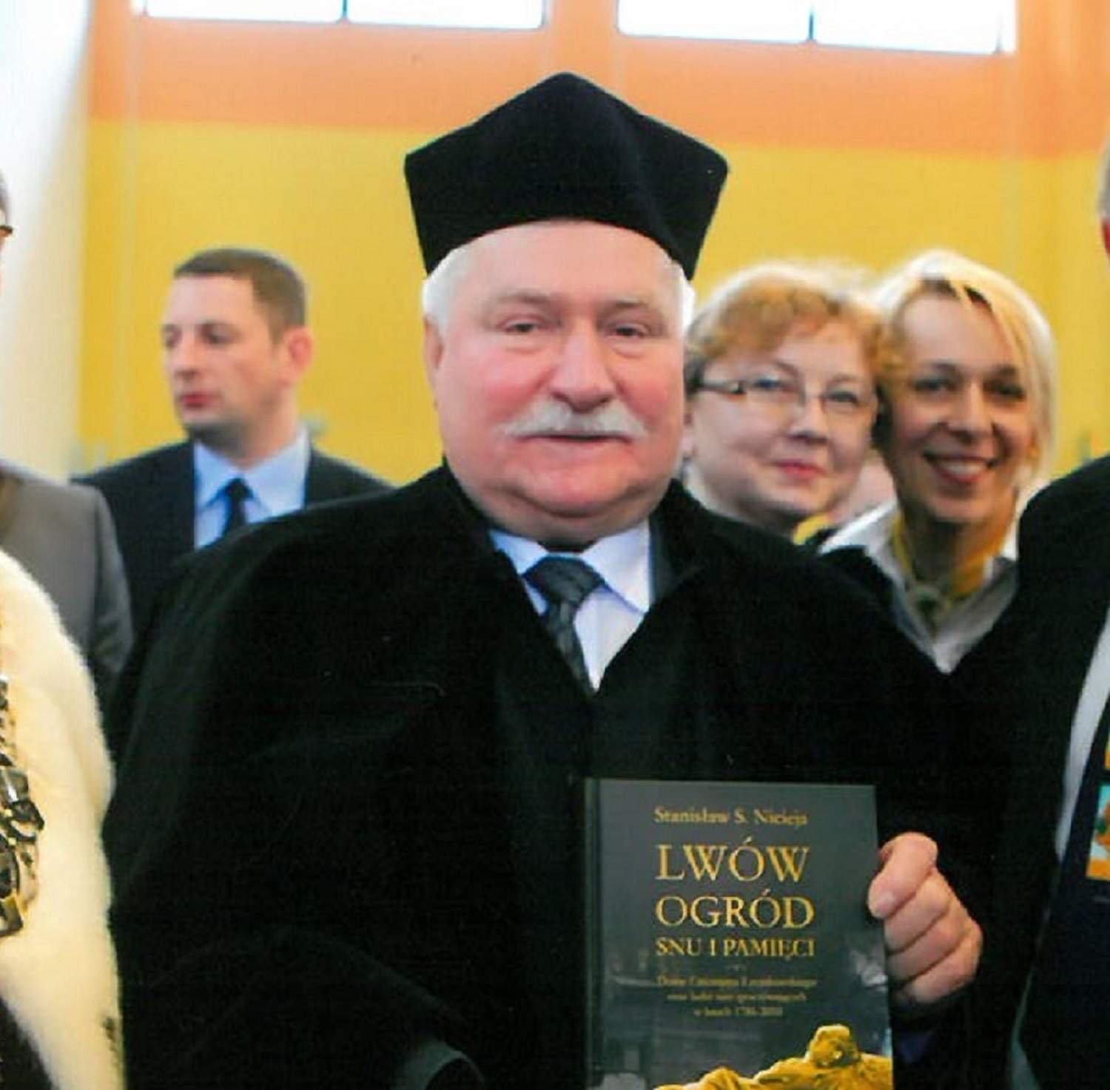
STANISŁAW LEM
PROF. ZBIGNIEW RELIGA
LECH WAŁĘSA
On December 8, 1997 the honorary doctorate of UO was awarded to one of the greatest and most recognizable in the world Polish writers.
A prominent heart surgeon, who was the first in Poland to perform a heart transplant, received the title on March 11, 2002.
The first democratically elected Polish President after the 2nd WW, Nobel Prize winner and the first leader of ‘Solidarity’ received the title on March 10, 2011.

Slide 21

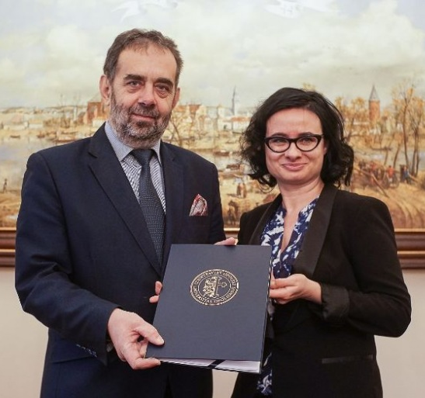
INTERNATIONAL COOPERATION
Our university participates in the FORTHEM consortium -
Fostering Outreach within European Regions, Transnational Higher Education and Mobility.
The alliance network has the Weimar Triangle as its core (Dijon, Mainz, and Opole), and represents the Scandinavian and Baltic region as well as the Iberian Peninsula (Jyväskylä, Riga, and Valencia) and goes deep into the south of Europe (Palermo).
In September 2021, two new universities, Universitetet i Agder (Norway) and Universitatea Lucian Blaga din Sibiu (Romania) chose to join FORTHEM.
IN ADDITION WE CONDUCT SUCH PROGRAMMES AS:
ERASMUS+ PROGRAMME
ALMOST 800
EUROPA MASTERS programme - the opportunity to simultaneously obtain master’s degrees from three universities: University of Opole, Johannes Gutenberg University of Mainz, Germany, and University of Burgundy in Dijon, France.
STUDENTS FROM
36 COUNTRIES
WE COOPERATE WITH THE WHOLE WORLD
The official signing of the partnership agreement of the FORTHEM consortium of European Universities by
Prof. Marek Masnyk. Rector of the University of Opole

Slide 22


INTERNATIONAL COOPERATION
Over 120 agreements
Various forms of exchange
University of Opole regularly signs cooperation agreements with universities from around the world. We have over 120 partners all over the world.
We cooperate with foreign countries in a number of ways: Erasmus+ programme, Europa Master, Language Summer School, or the Eastern Partnership.
Students from all over the world
Open to the world
Students from all the world come to our university. We host young people from nearby countries, such as Ukraine, Turkey, Spain, Belgium or Germany, but also from India, China, or Taiwan.
Students of the University of Opole also travel abroad. They can, within exchange programmes, not only go to all the EU countries but also to partner countries, such as China, Taiwan, Serbia, and many other.
Studenci z całego świata
Różne formy wymiany
Otwarci na świat
Naszą uczelnię odwiedzają studenci z całego świata. Gościmy młodych ludzi z pobliskich krajów, takich jak Ukraina, Turcja, Hiszpania, Belgia czy Niemcy, ale także z bardziej egzotycznych kierunków: Indii, Chin, Tajwanu.
Współpracujemy z zagranicą na wiele sposobów: Erasmus+, Europa Master, w ramach Językowej Szkoły Letniej czy Partnerstwa Wschodniego.
Studenci Uniwersytetu Opolskiego także wyjeżdżają za granicę. W ramach programu wymian mogą studiować w krajach Unii Europejskiej, ale także w Chinach, Tajwanie, Rosji, Serbii czy Izraelu.

Slide 23
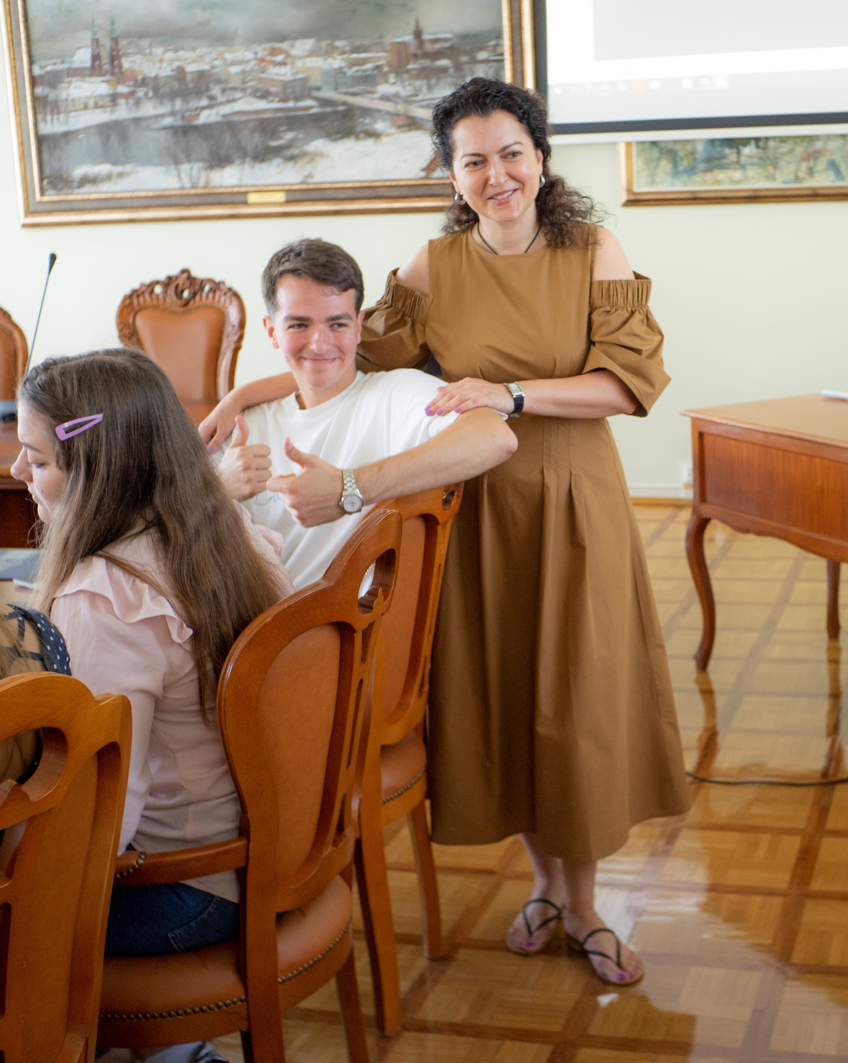
JĘZYKOWA SZKOŁA LETNIA
Language Summer School is organized by the Office of Academic and Student Affairs. The aim of the school is to prepare prospective students to study in Polish at the University of Opole.
It offers an interesting curriculum, which takes into account the history of Poland, region and city. Students take part in numerous trips, sport and cultural activities. Language classes are conducted by the qualified staff of the Faculty of Philology.
Each participant of the Language Summer School receives a certificate of completion.
23

Slide 24
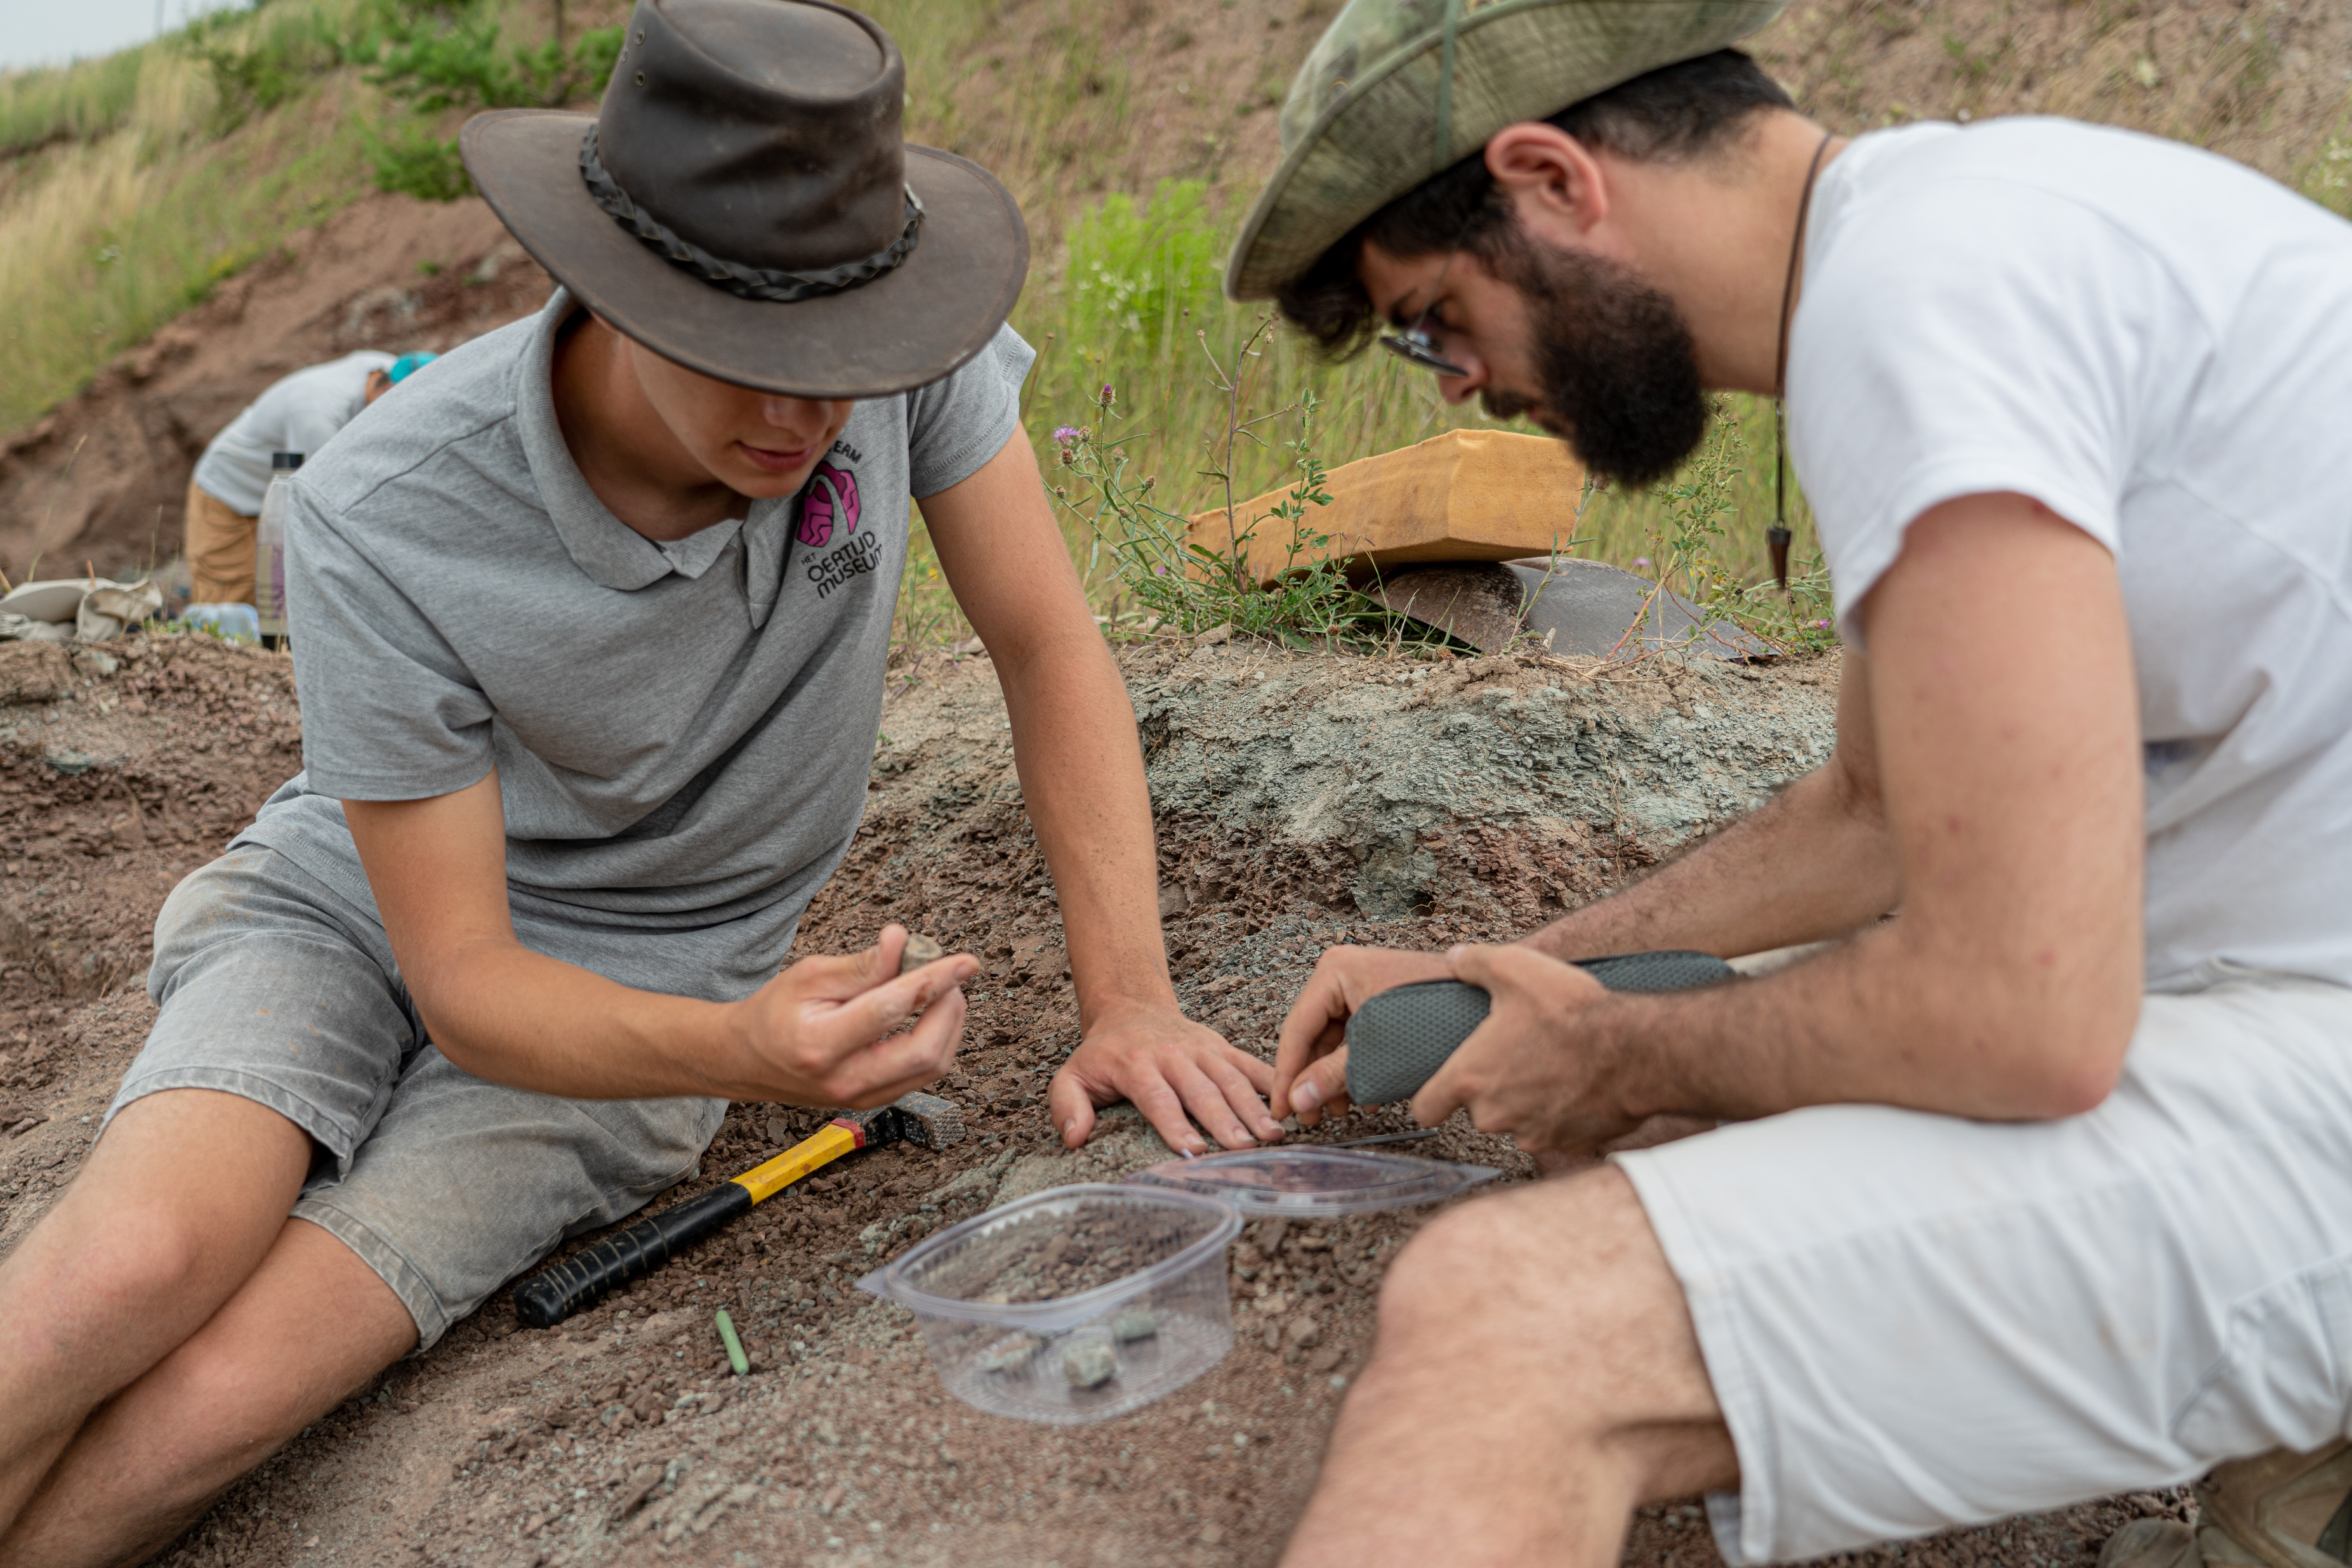
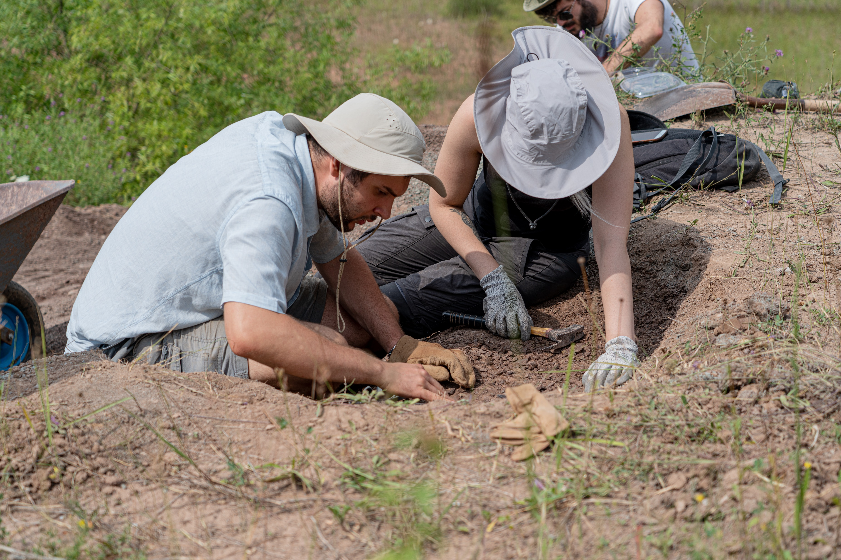
Krasiejów - graveyard of dinosaurs
The European Centre of Palaeontology, formed at the UO in 2016, aims to fully exploit the potential paleontological resources of the Opole region and to strengthen international cooperation in the field of palaeontology. The Faculty of Natural Sciences and Technology has a scientific supervision over the palaeontological excavation site in Krasiejów, which is considered to be one of the most valuable palaeontological sites in the world. A sensational discovery was made here of Triassic proto-dinosaurs. A few years ago an enormous dinopark was opened in the quarry.
The bones found in Krasiejów are dated at about 225 million years old.

Slide 25

SPORT IS OUR PASSION
The University of Opole is also a strong and vibrant sporting community. Students can pursue their passions in several sections and dozens of sports. The best compete in the Polish Universities Championships.
First league women’s volleyball team UniOpole, and badminton section regularly win the Polish Universities Championship.
12 sports sections
300 practising students
120 students representing the University in national competitions
15 sports competitions organised annually at the University
25

Slide 26

Opole Day of Sports
24-hour competition in 24 disciplines, organized
together with the Opole University of Technology
UO Champions League
It is a football League with teams representing all university faculties. The winner gets the Rector’s Cup.
Badminton
It is the most distinguished sports section of the UO. Our players have won four times in a row the Polish University Championship. They have also won numerous international tournaments.
Olympic athletes from the UO
Our former students: Adrian Dziółko - Olympic athlete at the 2016 Rio Olympics (badminton) , Janusz Trzepizur - Olympic athlete at the 1980 Moscow Olympics (high jump), Beata Kucharzewska - Olympic athlete at the 1996 Atlanta Olympics (judo)
Piast Rowing Regatta
It is a students’ project created and implemented by activists from the Academic Sports Association in which students from all over Poland come to Opole to take part in a ‘dragon boat’ race on the river Oder.
26

Slide 27
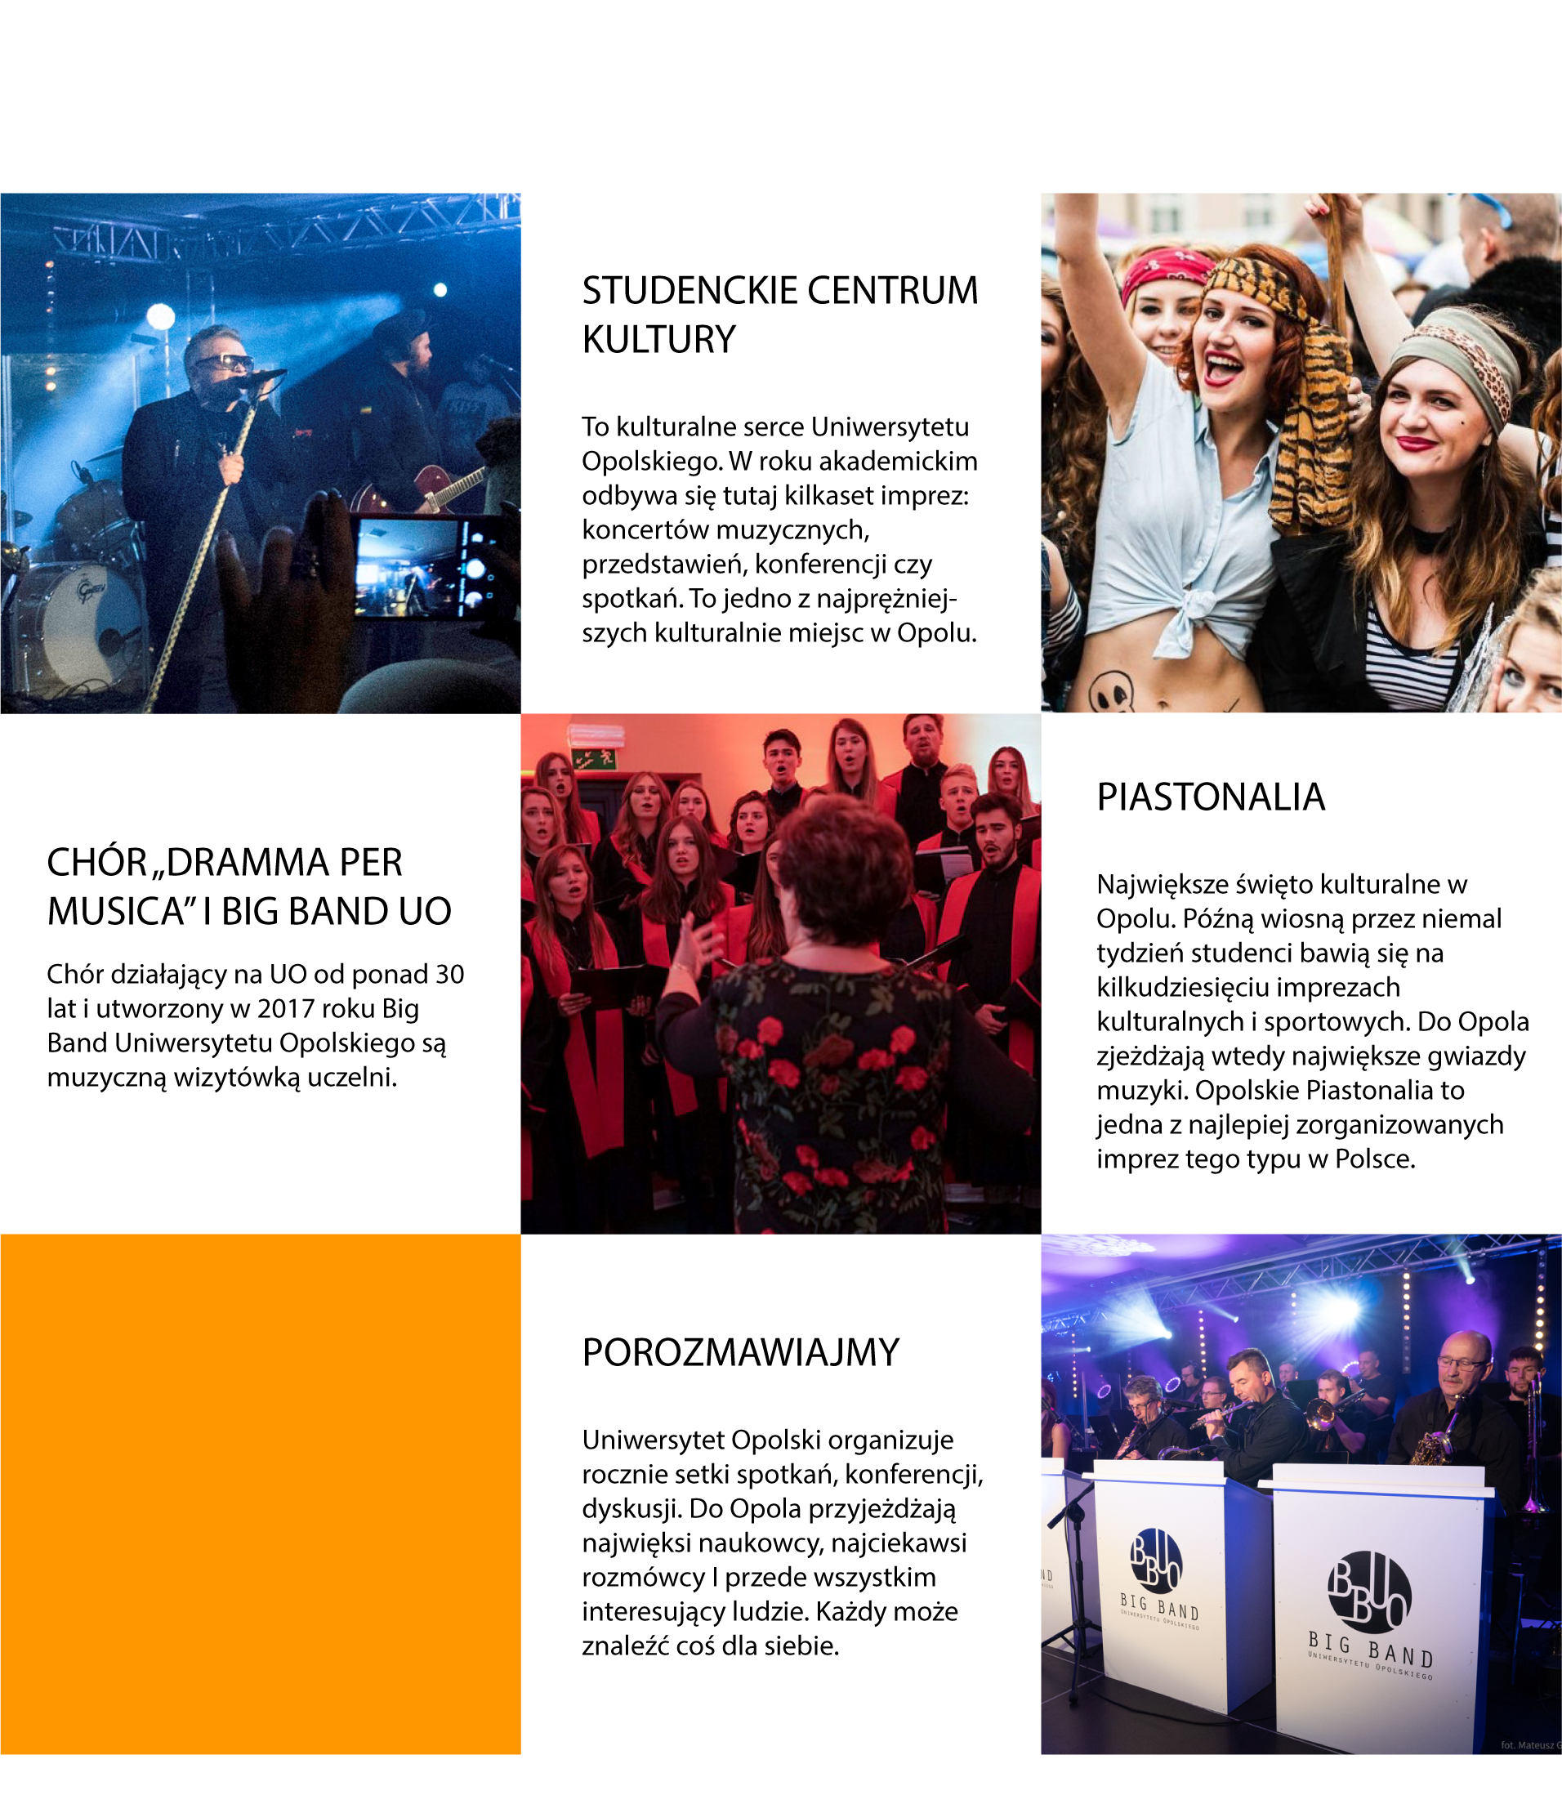
STUDENT CULTURAL CENTRE
This is the cultural heart of Opole University. Several hundred events take place here during the academic year: music concerts, performances, conferences or meetings. It is one of the most culturally vibrant places in Opole.
CULTURE
THE 'DRAMMA PER MUSICA' CHOIR AND THE UO BIG BAND
The choir, which has been active at the UO for over 30 years, and the Big Band of the University of Opole, formed in 2017, are the musical flagships of the university.
PIASTONALIA
The biggest cultural festiwal in Opole. In late spring, students have fun for almost a week at dozens of cultural and sporting events. The biggest music stars come to Opole at this time. The Opole Piastonalia is one of the best organised events of its kind in Poland.
LET'S TALK
The University of Opole organises hundreds of meetings, conferences and discussions every year. The greatest scientists, the most interesting speakers and, above all, interesting people come to Opole. Everyone can find something for themselves

Slide 28
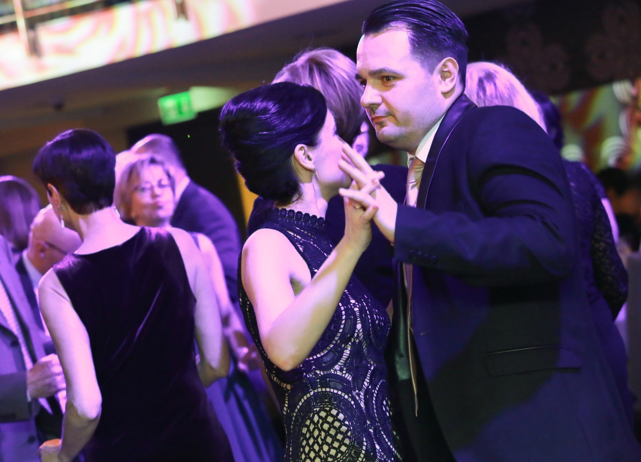
UNIVERSITY CARNIVAL BALL
Reactivated in 2016, the Ball of the UO is an unusual opportunity for the academic staff, students and friends of the University to party together. Representatives of local government are also invited to the ball.
Swinging fun with live music continues until dawn.
The ball is also a fund-raising event.

Slide 29
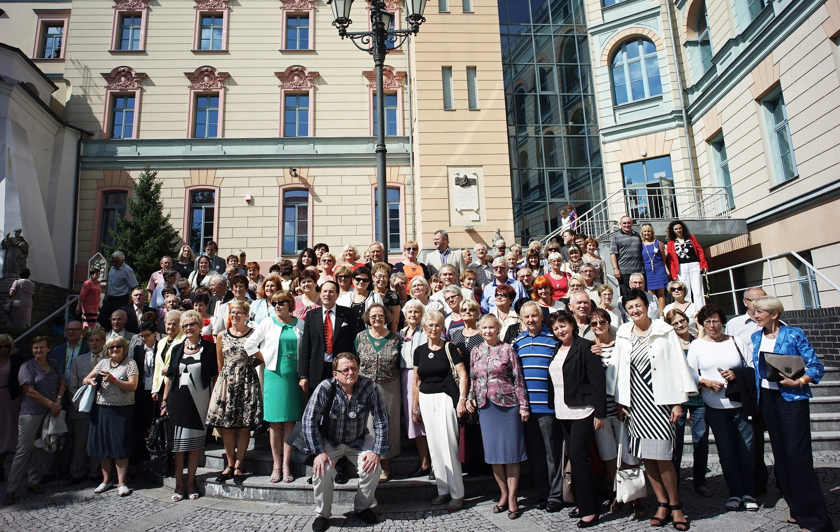
65-YEAR HISTORY
Once a student always a student
Our University does not forget about its alumni and they do not forget their Alma Mater. Alumni gladly come from all over the world to reunions organised by the University. For two days, the University is in their power.
100 000 graduates

Slide 30
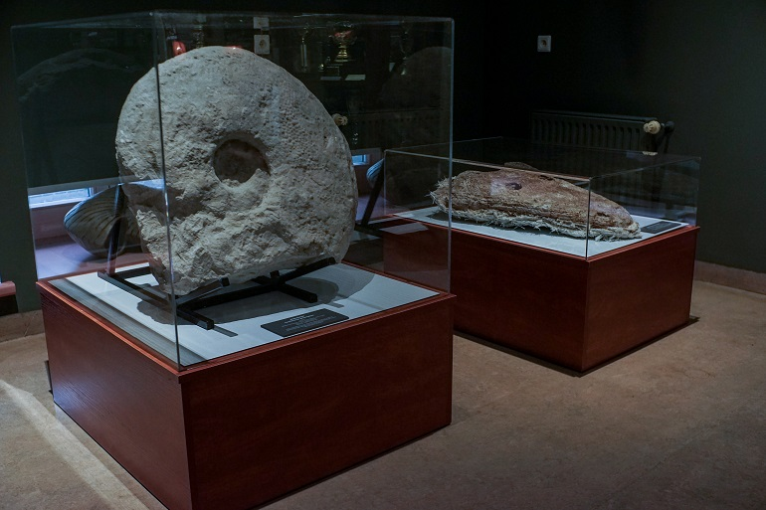
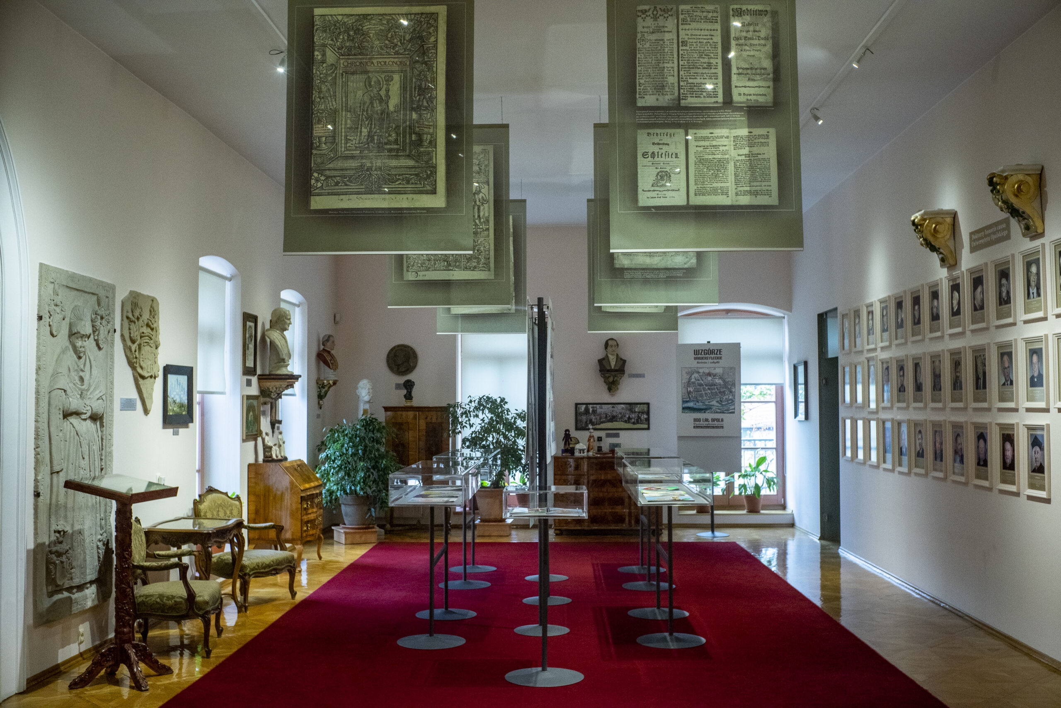
MUSEUM OF THE UNIVERSITY OF OPOLE
The museum is located in Collegium Maius.
It consists of five beautifully designed rooms. The museum’s mission is to store, provide documentation and exhibit relics and works of art testifying to the history and contemporary days of the University of Opole and its vital role as a cultural and academic centre in the Opole region.
The museum also functions as an educational centre which promotes knowledge about the history of the University of Opole and popularises interesting aspects of science, culture and art.
The roots must be respected. We need to show to the next generations where we come from, because it gives us strength, imagination and ambitions for the future.
Prof. Stanisław Sławomir Nicieja,
founder of the University Museum,
curator of the Collegium Maius

Slide 31
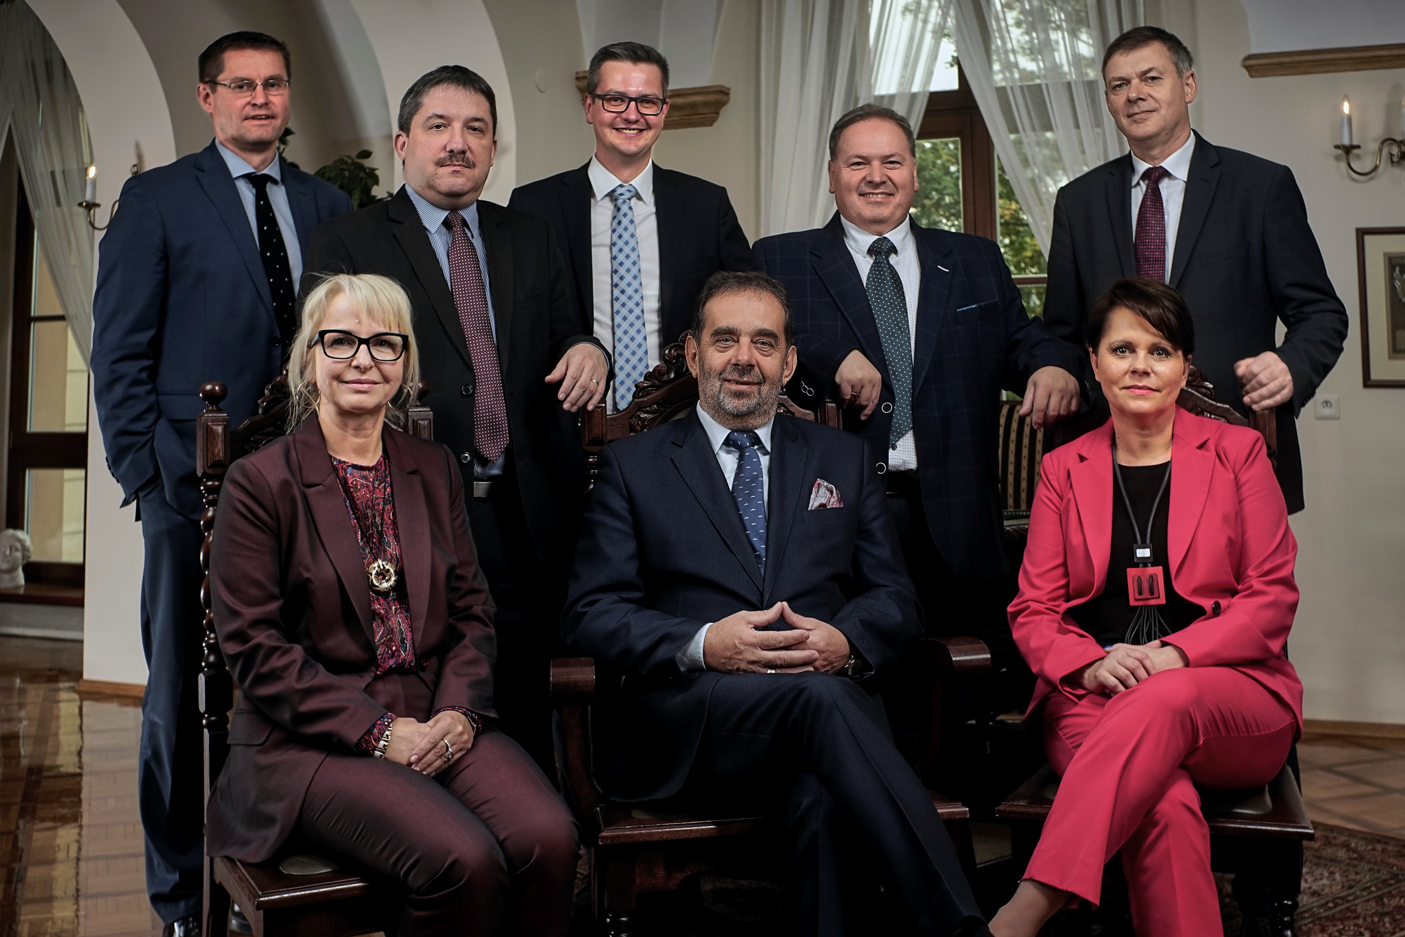
THANK YOU FOR YOUR ATTENTION
Plac Kopernika 11a, 45-040 Opole
+48 77 452 70 00
sekretariat@uni.opole.pl
www.uni.opole.pl
facebook.com/UniwersytetOpolski
twitter.com/uniopole
Authorities of the University of Opole,
with Prof. Marek Masnyk, Rector of the UO (in the middle)
31

